Slide 1
Physically-based
Facial Modeling
COMP 259
Spring 2006

Slide 2
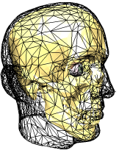
Overview
Motivation
Facial Anatomy
Historical view
Techniques
  Traditional animation
  Muscle-vector techniques
  Mass-spring + muscles
  Finite-element + muscles
An aside: speech

Slide 3
Motivation
Why a talking head?
  Enhanced communication for people with disabilities
  Training scenario software
  Entertainment: Games and Movies
Why physically based?
  Unburdens animators
  Provides more realistic looking simulations

Slide 4
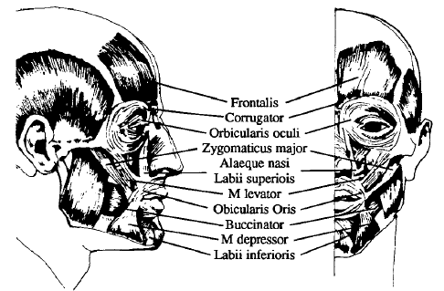
Anatomy of the face
There are 268 voluntary muscles that contribute to your expression!
Three main types:
Linear muscles (share a common anchor)
Sheet muscles (run parallel, activated together)
Sphincter muscles (contract to a center point)

Slide 5
Muscles
Bundles of thousands of individual fibers
  Thankfully, can be modeled as these bundles
  When activated, all of the fibers contract
Contraction only
  Most parts of the body use opposing pairs of muscles, but the face relies on the skin
Bulging
  Occurs due to volume preservation
  Thicker on contraction, thinner on elongation
  Important for realistic faces (e.g. pouting lips)

Slide 6
Skin
Epidermis
  Thin, stiff layer of dead skin
Dermis
  Primary mechanical layer
  Collagen and Elastin fibers
Subcutaneous or Fatty tissue
  Allows skin to slide over muscle bundles
  Varies in thickness

Slide 7
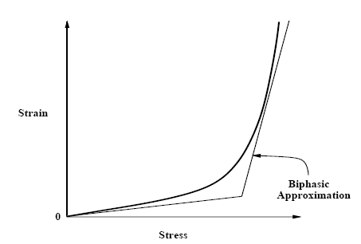
Modeling viscoelastic skin
Collagen fibers - low strain for low extensions
Near maximum expansion, strain rises quickly
When allowed to, elastin fibers return system to rest state quickly
stress
Biphasic model:
Two piecewise linear modes
Threshold extension to pick spring constant
stress
strain

Slide 8
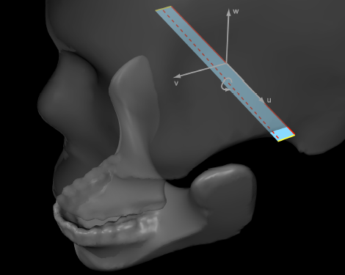
The skull
Unlike most of the body, the face only has a single joint
All other expression is due to computer-unfriendly soft tissues
Can be treated as a rigid body

Slide 9
Facial Action Coding System (FACS)
Proposed by Ekman and Friesan in 1978.
Describes facial movement in terms of the muscles involved
Purposely ignores invisible and non-movement changes (such as blushing)
Defines 46 action units pertaining to expression-related muscles
Additional 20 action units for gross head movement and eye gaze.

Slide 10
Traditional techniques
Key-framing
  Extremely fast
  Extremely hard to model appropriately
  Large storage footprint
  Basically never used to edit faces, but works as a final format, especially for games
MPEG-4 approach
  Defines 84 feature points with position and zone of influence on a few basis keyframes of a standard 3D mesh
  Defines animation independently of the visual rep.

Slide 11
MPEG-4 Facial Animation
  68 facial action parameters (FAPs), defined in terms of face independent FAP units (FAPUs)
  Most define a rotation or translation of one or more feature points, with a few selecting entirely new key frames (e.g. an emotion basis)
  Same animation can be used on different model, provided the model is properly annotated
Some MPEG-4 feature points

Slide 12
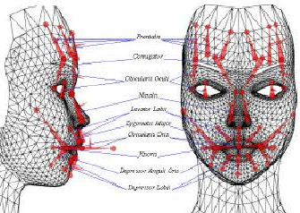
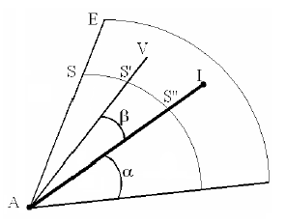
Muscle vectors
Muscle vector properties
  Attachment point (to bone)
  Insertion point (to skin)
Influences nearby skin vertices, more strongly along the direction vector and close to the muscle.

Slide 13
Muscle vectors (2)
Advantages
  Fast
  Compact, easily controlled
Disadvantages
  Treats the skin like a 2D surface, no concept of curvature
  Artifacts when vertices are within two influences
For more information, see Jason Jerald’s slides from 2004 (on course website)

Slide 14
Mass-spring models
Model the skin (and sometimes muscle and bones) as a number of point masses connected by springs, like a cloth

Slide 15
Terzopoulos and Waters
Terzopoulos90 models the entire face as a three-layer mass-spring system
Horizontal layers and interconnects:
  Epidermis
  Fatty tissue
  Underlying bone.
Vertical interconnects:
  Top-to-middle springs correspond to the dermis
  Middle-to-bottom springs provide the simulation of muscle fibers.

Slide 16
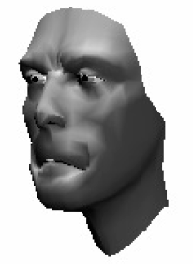
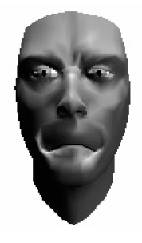
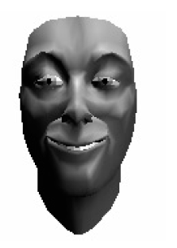
Terzopoulos and Waters (cont)

Slide 17
Terzopoulos and Waters (cont)
Simplifies implementation: everything is handled in a single system
Fast: interactive rates in 1990 (not on a desktop PC)
Provides some wrinkle effects
Unrealistic model of muscles and bone
Cannot control via muscle activations

Slide 18
Kähler, et al.
Model the muscles as ellipsoids
Long or curved muscles are broken into piecewise linear segments
Scale the diameter as length changes to implement bulging in a nearly volume-preserving manner.

Slide 19
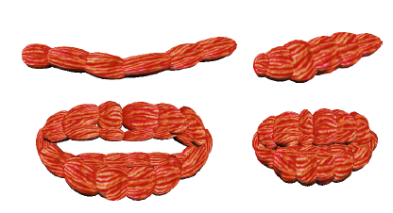
Kähler, et al.

Slide 20
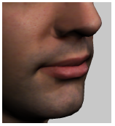
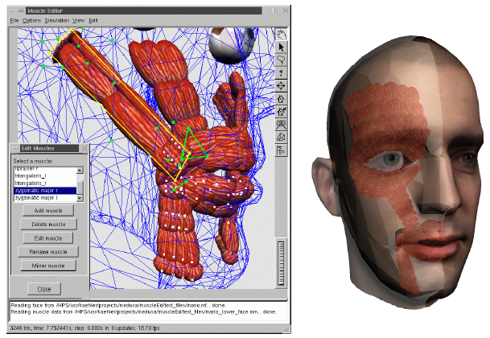
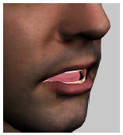
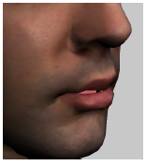
Kähler, et al.

Slide 21
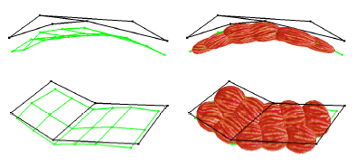
Kähler, et al. - Editor
Also present an easy-to-use editor to define muscles
  Provided a skin model, automatically creates skull
  Users sketch sheets of muscles and they are iteratively subdivided into individual muscle chains of ellipsoids
  Automatic fitting process to place the ellipsoids underneath the skin.

Slide 22
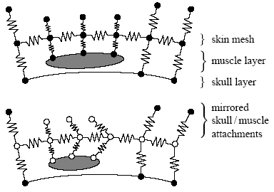
‘Preservation’ springs
To prevent interpenetrations, Kähler use preservation springs.
Each skin-muscle and skin-bone attachment point gets a mirrored phantom preservation spring acting on it.
Similar to penalty based approaches

Slide 23
Finite-element models
Break the system down into a regular discretized representation (e.g. tetrahedrons)
Comparison to mass-spring
  More accurate
  More stable
  Far more expensive

Slide 24
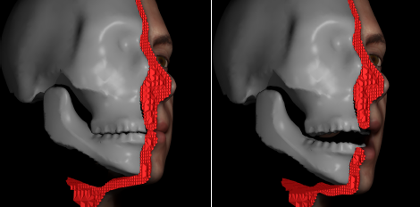
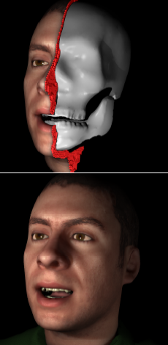
Finite-element skin
Beautiful results
8 minutes per frame*
Creepy video demo

Slide 25
An aside: Speech
Phones and phonemes: Unit of sound versus unit of perception
English is considered to have 44 phonemes: 20 vowels and 24 consonants, less per dialect
Distinguishing factors:
  Place of articulation (teeth, lips, etc…)
  Manner of articulation (flow rate, sort of)

Slide 26
An aside: What is speech?
From top to bottom: Amplitude, spectrogram, timeline, and pitch contour, for the word “Welcome” (W EH L - K AH M)

Slide 27
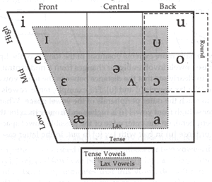
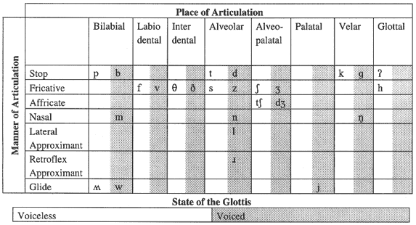
Parts of speech
Not all changes are visible
  Try saying ‘b’, ‘p’, ‘t’
Concept of Visemes
  Speech readers say 18
  Disney says 12
  Some games use 6
Coarticulation
  Or, why we don’t have good speech interfaces yet
Vowels
Consonants

Slide 28
Paper References
E. Sifakis, I. Neverov, R. Fedkiw, Automatic Determination of Facial Muscle Activations from Sparse Motion Capture Marker Data, 2005
D. Terzopoulos, Waters, K., Physically-Based Facial Modeling, Analysis, and Animation, The Journal of Visualization and Computer Animation, 1990
K. Waters, A muscle model for animating three-dimensional facial expressions, SIGGRAPH’87
K. Kahler, J. Haber, H.-P. Seidel, Geometry-based muscle modeling for facial animation, Proceedings Graphics Interface 2001
MPEG-4 standard
[Cohen93] M. M. Cohen, D.W. Massaro. Modeling coarticulation in synthetic visual speech, Computer Animation '93. Springer-Verlag, 1993.

Slide 29
Video References
http://graphics.stanford.edu/~fedkiw/

