Slide 1
Stable Fluids CSCI 520 Computer Animation and Simulation Huanyu Chen, 2025

Slide 2
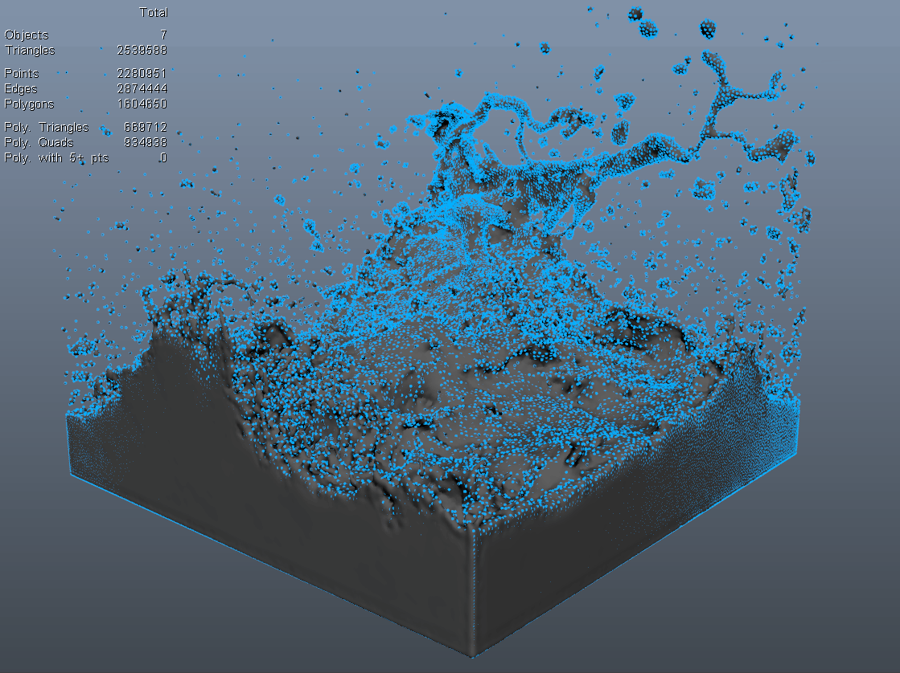
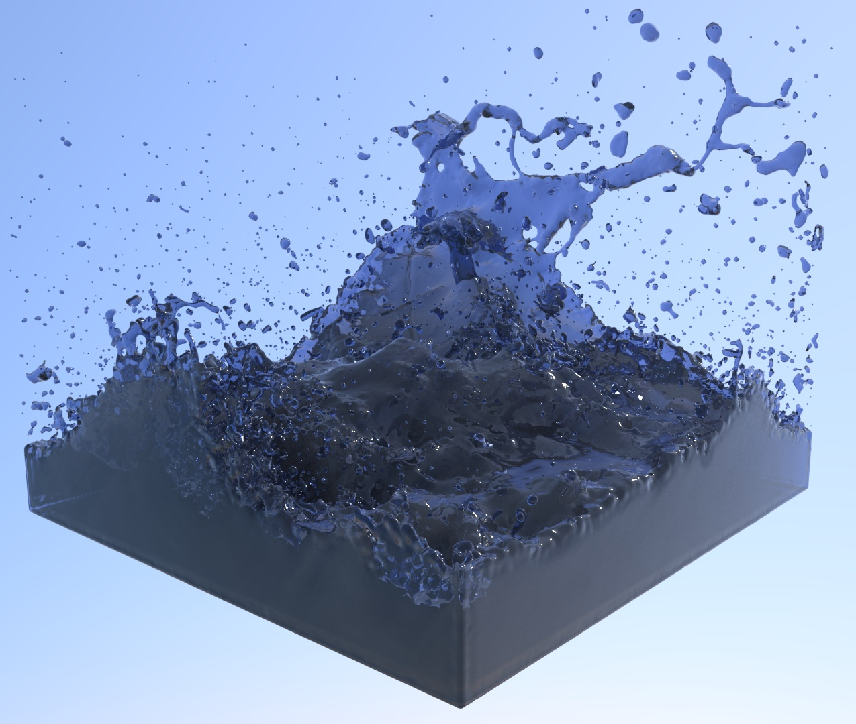
What Are Fluids?
Liquids
Gases
Granular
Notes:
Liquids: water, pigment
Gases: wind, smoke
Granular: sand, snow
Others: fire

Slide 3
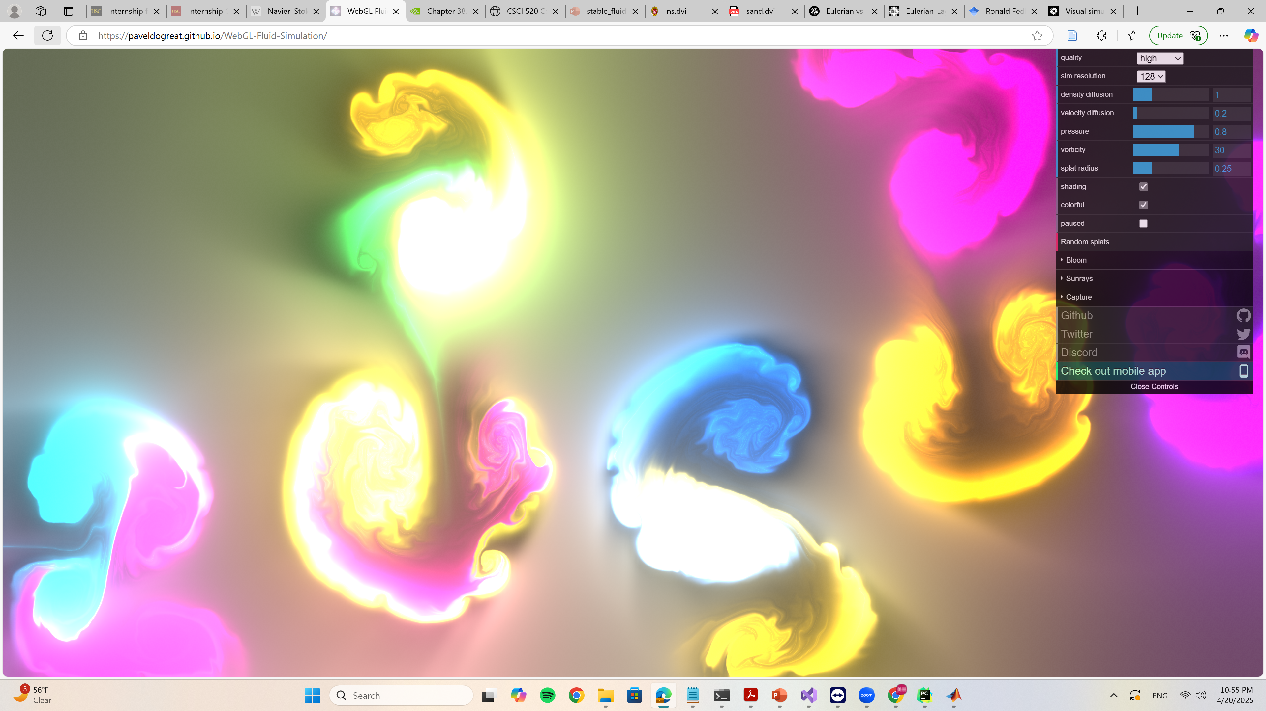
Demo: WebGL Fluid Simulator

Slide 4
Demo: Avatar: The Way of Water

Slide 5
The Navier-Stokes Equations
$$\frac{D\overset{⃑}{u}}{Dt}=\frac{1}{ρ}∇⋅σ+\overset{⃑}{f}$$
Or after expansion,
$$\frac{∂\overset{⃑}{u}}{∂t}=−\left(\overset{⃑}{u}⋅∇\right)\overset{⃑}{u}−\frac{1}{ρ}∇p+νΔ\overset{⃑}{u}+\overset{⃑}{f}$$
Notes:
The math foundation of fluid simulation
The newton second law for fluid

Slide 6
Different Approaches
Eulerian
Tracks properties at fixed grid points
Grid-based
Good for capturing flow
Examples:
MAC (Marker And Cell)
Stable Fluids
Lagrangian
Tracks individual particles
Particles or mesh
Good for shape deformation
Examples:
SPH (Smoothed Particle Hydrodynamics)
Vortex sheets method
Hybrid Approaches
FLIP (Fluid Implicit Particle)
APIC (Affine Particle in Cell)
MPM (Material Point Method)

Slide 7
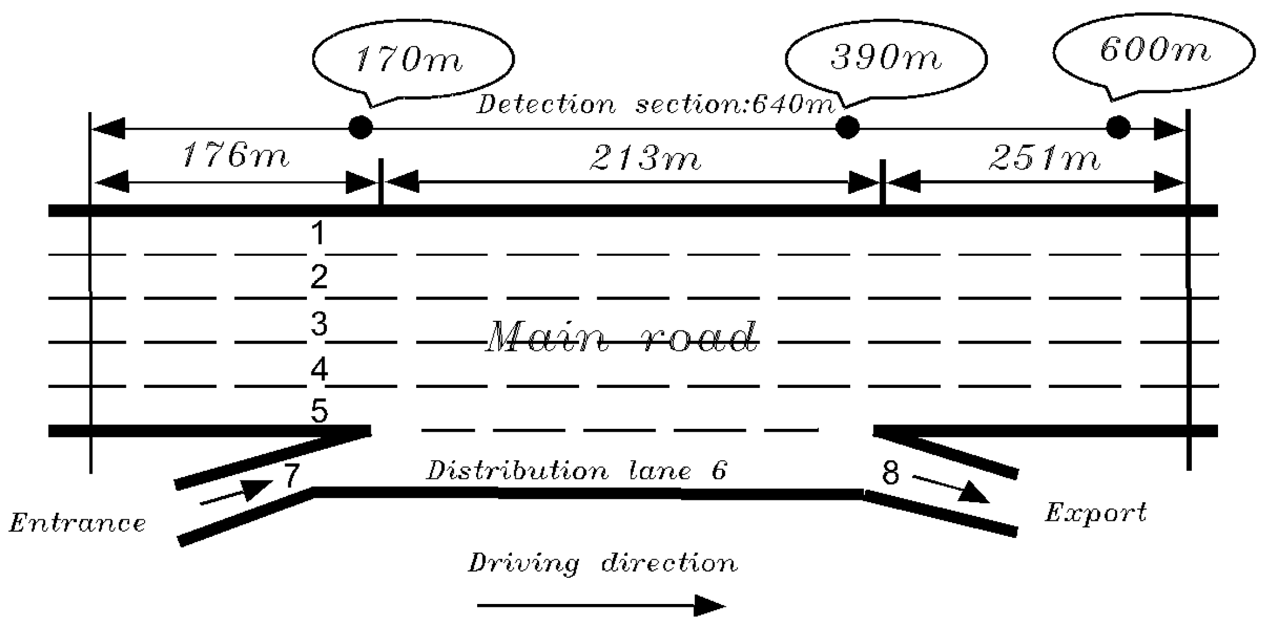
1D Example: Cars on a Freeway
$$x$$

Slide 8
1D Example: Cars on a Freeway
$$u\left(x, t\right)$$
$$x$$
Eulerian
Tracks a fix point on the road
Velocity field: $u\left(x, t\right)$
Like a speed trap

Slide 9
1D Example: Cars on a Freeway
$$x_{i}\left(t\right)$$
$$u_{i}\left(t\right)$$
$$x$$
Eulerian
Tracks a fix point on the road
Velocity field: $u\left(x, t\right)$
Like a speed trap
Lagrangian
Tracks an individual car
Car position/velocity: $x_{i}\left(t\right), u_{i}\left(t\right)$
Like a speedometer on the car

Slide 10
1D Example: Cars on a Freeway
$$ρ\left(x, t\right)$$
$$x$$
More Eulerian Concepts
Density: $ρ\left(x, t\right)$, number of cars per unit length near $x$ at time $t$
Flux: $ρ\left(x, t\right)⋅u\left(x, t\right)$, number of cars passing the red line per unit time
Source/Sink: $s\left(x, t\right)$, number of cars entering/exiting the freeway

Slide 11
1D Example: Cars on a Freeway
$$x=a$$
$$x=b$$
$$x$$
Divergence Theorem
For close interval $[a, b]$, the net flux out equals the total source inside:
$$ρ\left(u\left(b, t\right)−u\left(a, t\right)\right)=\int_{a}^{b}{s\left(x, t\right)dx}$$
Assumes constant density
Local form: $s\left(x, t\right)=ρ\frac{∂u\left(x, t\right)}{∂x}$
Newton-Leibniz formula!

Slide 12
1D Example: Cars on a Freeway
$$x=a$$
$$x=b$$
$$x$$
Full Picture: Conservation of Cars
If density changes:
$$s\left(x, t\right)=\frac{∂ρ}{∂t}+\frac{∂}{∂x}\left(ρu\right)$$
Integral form:
$$\frac{d}{dt}\int_{a}^{b}{ρ\left(x, t\right)dx}+{\left[ρu\right]}_{a}^{b}=\int_{a}^{b}{s\left(x, t\right)dx}$$

Slide 13
1D Example: Cars on a Freeway
$$x_{i}\left(t\right)$$
$$u_{i}\left(t\right)$$
$$x$$
Advection
$φ\left(x, t\right)$: a scalar quantity being carried by the car flow, e.g. number of people
$$\frac{d}{dt}φ\left(x_{i}\left(t\right), t\right)=\left(\frac{∂φ}{∂t}+u\frac{∂φ}{∂x}\right)\left(x_{i}, t\right)$$
Material derivative of $φ\left(x, t\right): \frac{D}{Dt}φ\left(x, t\right)≔\frac{∂φ\left(x, t\right)}{∂t}+u\left(x, t\right)\frac{∂φ\left(x, t\right)}{∂x}$
resembles speed of change of $φ\left(x, t\right)$ in Lagrangian view.
Material derivative of velocity: $\frac{∂u\left(x, t\right)}{∂t}+u\left(x, t\right)\frac{∂u\left(x, t\right)}{∂x}$
resembles acceleration in Lagrangian view.

Slide 14
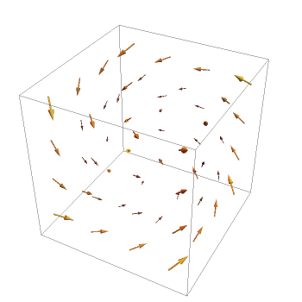
3D Flow
How do these terms generalize to 3D?
Velocity field
Density
Flux
Source
Advection
Material derivative

Slide 15
1D vs 3D
Velocity | $$u\left(x, t\right)$$ | $$\overset{⃑}{u}\left(\overset{⃑}{x}, t\right)$$
Mass Density | $$ρ\left(x, t\right)$$ | $$ρ\left(\overset{⃑}{x}, t\right)$$
Mass Flux | $${\left.ρ\left(x, t\right)u\left(x, t\right)\right|}_{x=a}^{x=b}$$ | $$\iint_{S}{ρ\left(\overset{⃑}{x}, t\right)\overset{⃑}{u}\left(\overset{⃑}{x}, t\right)⋅\overset{⃑}{n}}dA$$
Mass Source | $$s\left(x, t\right)=\frac{∂ρ}{∂t}+\frac{∂}{∂x}\left(ρu\right)$$ | $$s\left(\overset{⃑}{x}, t\right)=\frac{∂ρ}{∂t}+∇⋅\left(ρ\overset{⃑}{u}\right)$$
Divergence Theorem | $$\int_{a}^{b}{\frac{dF}{dx}\left(x\right)dx}=F\left(b\right)−F\left(a\right)$$ | $$\iiint_{Ω}{∇⋅\overset{⃑}{F} dV}=∯_{∂Ω}{\overset{⃑}{F}⋅\overset{⃑}{n} dA}$$
Material Derivative | $$\frac{D}{Dt}φ\left(x, t\right)=\frac{∂φ}{∂t}+u\frac{∂φ}{∂x}$$ | $$\frac{D}{Dt}φ\left(\overset{⃑}{x}, t\right)=\frac{∂φ}{∂t}+\left(\overset{⃑}{u}⋅∇\right)φ$$
Acceleration | $$\frac{D}{Dt}u\left(x, t\right)=\frac{∂u}{∂t}+u\frac{∂u}{∂x}$$ | $$\frac{D}{Dt}\overset{⃑}{u}\left(\overset{⃑}{x}, t\right)=\frac{∂\overset{⃑}{u}}{∂t}+\left(\overset{⃑}{u}⋅∇\right)\overset{⃑}{u}$$

Slide 16
3D Vector Calculus
$Ω⊂ℝ^{3}$, region of interest
Scalar field: $φ:Ω→ℝ$, smooth
Example: inner product $φ\left(\overset{⃑}{x}\right)=\overset{⃑}{a}⋅\overset{⃑}{x}$, $\overset{⃑}{a}∈ℝ^{3}$
Example: density $ρ=ρ\left(\overset{⃑}{x}, t\right)$
Set of all scalar field $C^{∞}\left(Ω\right)≔\left\{φ:Ω→ℝ\right\}$
Vector field: $\overset{⃑}{F}=\left(F_{x}, F_{y}, F_{z}\right):Ω→ℝ^{3}$, smooth
Example: constant vector $\overset{⃑}{F}\left(\overset{⃑}{x}\right)=\overset{⃑}{a}$
Example: linear map $\overset{⃑}{F}\left(\overset{⃑}{x}\right)=A\overset{⃑}{x}$, $A∈ℝ^{3×3}$
Example: velocity $\overset{⃑}{u}=\overset{⃑}{u}\left(\overset{⃑}{x}, t\right)=\left(\begin{matrix}u_{x}\left(x, y, z, t\right) \\ u_{y}\left(x, y, z, t\right) \\ u_{z}\left(x, y, z, t\right)\end{matrix}\right)$
Set of all vector field $C^{∞}{\left(Ω\right)}^{3}≔\left\{\overset{⃑}{F}:Ω→ℝ^{3}\right\}$

Slide 17
3D Vector Calculus
Gradient of a scalar field:
$$grad φ≔∇φ=\frac{dφ\left(\overset{⃑}{x}\right)}{d\overset{⃑}{x}}=\left(\frac{∂φ}{∂x},\frac{∂φ}{∂y}, \frac{∂φ}{∂z}\right)∈C^{∞}{\left(Ω\right)}^{3}$$
Example: $φ\left(\overset{⃑}{x}\right)=\overset{⃑}{a}⋅\overset{⃑}{x}$, $∇φ\left(\overset{⃑}{x}\right)=\overset{⃑}{a}$
Example: $φ\left(\overset{⃑}{x}\right)={\left|\overset{⃑}{x}\right|}^{2}=\overset{⃑}{x}⋅\overset{⃑}{x}$, $∇φ\left(\overset{⃑}{x}\right)=2\overset{⃑}{x}$
Example: $φ\left(\overset{⃑}{x}\right)=\left|\overset{⃑}{x}\right|=\sqrt{\overset{⃑}{x}⋅\overset{⃑}{x}}$, $∇φ\left(\overset{⃑}{x}\right)=\frac{\overset{⃑}{x}}{\left|\overset{⃑}{x}\right|}$
The Nabla symbol: $∇ ≔\left(\frac{∂}{∂x},\frac{∂}{∂y}, \frac{∂}{∂z}\right)$
Product rule: $∇\left(fg\right)=f∇g+g∇f$
Chain rule: $∇\left(f∘g\right)=\frac{df\left(g\left(\overset{⃑}{x}\right)\right)}{d\overset{⃑}{x}}=f^{′}\left(g\left(\overset{⃑}{x}\right)\right)\frac{dg\left(\overset{⃑}{x}\right)}{d\overset{⃑}{x}}=\left(f^{′}∘g\right)∇g$

Slide 18
3D Vector Calculus
Gradient of a vector field:
$$grad \overset{⃑}{F}≔∇\overset{⃑}{F}=\frac{d\overset{⃑}{F}\left(\overset{⃑}{x}\right)}{d\overset{⃑}{x}}=\left(\begin{matrix}\frac{∂F_{x}}{∂x} & \frac{∂F_{x}}{∂y} & \frac{∂F_{x}}{∂z} \\ \frac{∂F_{y}}{∂x} & \frac{∂F_{y}}{∂y} & \frac{∂F_{y}}{∂z} \\ \frac{∂F_{z}}{∂x} & \frac{∂F_{z}}{∂y} & \frac{∂F_{z}}{∂z}\end{matrix}\right)∈C^{∞}{\left(Ω\right)}^{3×3}$$
Example: $\overset{⃑}{F}\left(\overset{⃑}{x}\right)=A\overset{⃑}{x}$, $∇\overset{⃑}{F}\left(\overset{⃑}{x}\right)=A$
Product rule: $∇\left(φ\overset{⃑}{F}\right)={\overset{⃑}{F}}^{T}∇φ+φ∇\overset{⃑}{F}$
Product rule: $∇\left(\overset{⃑}{F}⋅\overset{⃑}{G}\right)={\overset{⃑}{F}}^{T}∇\overset{⃑}{G}+{\overset{⃑}{G}}^{T}∇\overset{⃑}{F}$
Chain rule: $\frac{d\left(\overset{⃑}{F}∘\overset{⃑}{G}\right)}{d\overset{⃑}{x}}\left(\overset{⃑}{x}\right)=\frac{d\overset{⃑}{F}}{d\overset{⃑}{x}}\left(\overset{⃑}{G}\left(\overset{⃑}{x}\right)\right)\frac{d\overset{⃑}{G}}{d\overset{⃑}{x}}\left(\overset{⃑}{x}\right)$

Slide 19
3D Vector Calculus
Curl of a vector field:
$$curl \overset{⃑}{F}≔∇×\overset{⃑}{F}=\left(\frac{∂F_{z}}{∂y}−\frac{∂F_{y}}{∂z},\frac{∂F_{x}}{∂z}−\frac{∂F_{z}}{∂x},\frac{∂F_{y}}{∂x}−\frac{∂F_{x}}{∂y}\right)∈C^{∞}{\left(Ω\right)}^{3}$$

Slide 20
3D Vector Calculus
$$∇\overset{⃑}{F}=\left(\begin{matrix}\frac{∂F_{x}}{∂x} & \frac{∂F_{x}}{∂y} & \frac{∂F_{x}}{∂z} \\ \frac{∂F_{y}}{∂x} & \frac{∂F_{y}}{∂y} & \frac{∂F_{y}}{∂z} \\ \frac{∂F_{z}}{∂x} & \frac{∂F_{z}}{∂y} & \frac{∂F_{z}}{∂z}\end{matrix}\right)$$
Curl of a vector field:
$$curl \overset{⃑}{F}≔∇×\overset{⃑}{F}=\left(\frac{∂F_{z}}{∂y}−\frac{∂F_{y}}{∂z},\frac{∂F_{x}}{∂z}−\frac{∂F_{z}}{∂x},\frac{∂F_{y}}{∂x}−\frac{∂F_{x}}{∂y}\right)∈C^{∞}{\left(Ω\right)}^{3}$$
Example: $\overset{⃑}{F}\left(\overset{⃑}{x}\right)=A\overset{⃑}{x}$, $∇×\overset{⃑}{F}\left(\overset{⃑}{x}\right)=\left(A_{32}−A_{23}, A_{13}−A_{31}, A_{12}−A_{21}\right)$
Example: $\overset{⃑}{F}\left(\overset{⃑}{x}\right)=\overset{⃑}{ω}×\overset{⃑}{x}={\left[\overset{⃑}{ω}\right]}_{×}\overset{⃑}{x}$, $∇×\overset{⃑}{F}\left(\overset{⃑}{x}\right)=2\overset{⃑}{ω}$
$$\overset{⃑}{ω}=\left(\begin{matrix}0 \\ 0 \\ 1\end{matrix}\right)$$

Slide 21
3D Vector Calculus
Divergence of a vector field:
$$div \overset{⃑}{F}≔∇⋅\overset{⃑}{F}=\frac{∂F_{x}}{∂x}+\frac{∂F_{y}}{∂y}+\frac{∂F_{z}}{∂z}∈C^{∞}\left(Ω\right)$$

Slide 22
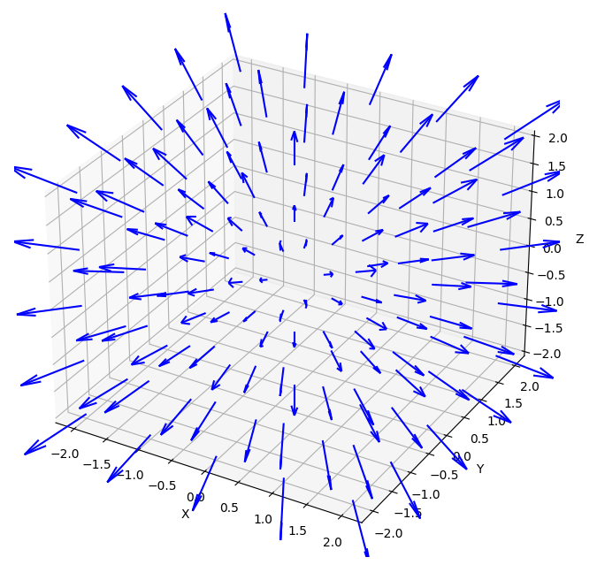
3D Vector Calculus
$$∇\overset{⃑}{F}=\left(\begin{matrix}\frac{∂F_{x}}{∂x} & \frac{∂F_{x}}{∂y} & \frac{∂F_{x}}{∂z} \\ \frac{∂F_{y}}{∂x} & \frac{∂F_{y}}{∂y} & \frac{∂F_{y}}{∂z} \\ \frac{∂F_{z}}{∂x} & \frac{∂F_{z}}{∂y} & \frac{∂F_{z}}{∂z}\end{matrix}\right)$$
Divergence of a vector field:
$$div \overset{⃑}{F}≔∇⋅\overset{⃑}{F}=\frac{∂F_{x}}{∂x}+\frac{∂F_{y}}{∂y}+\frac{∂F_{z}}{∂z}∈C^{∞}\left(Ω\right)$$
Example: $\overset{⃑}{F}\left(\overset{⃑}{x}\right)=A\overset{⃑}{x}$, $∇⋅\overset{⃑}{F}\left(\overset{⃑}{x}\right)=A_{11}+A_{22}+A_{33}=tr A$
$$A=\left(\begin{matrix}1 & 0 & 0 \\ 0 & 1 & 0 \\ 0 & 0 & 1\end{matrix}\right)$$

Slide 23
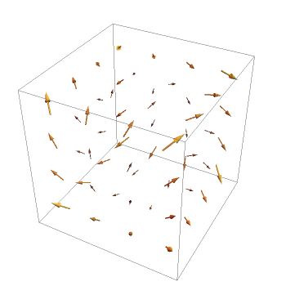
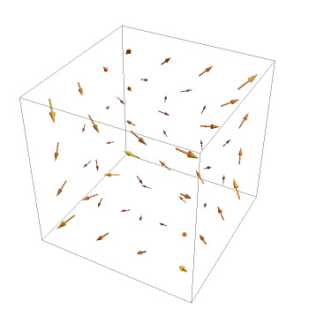
3D Vector Calculus
$$\overset{⃑}{F}\left(x, y, z\right)$$ | $$\left(x, z, y\right)$$ | $$\left(z, x, y\right)$$ | $$\left(−y, −z, x\right)$$
$$grad \overset{⃑}{F}$$ | $$\left(\begin{matrix}1 & 0 & 0 \\ 0 & 0 & 1 \\ 0 & 1 & 0\end{matrix}\right)$$ | $$\left(\begin{matrix}0 & 0 & 1 \\ 1 & 0 & 0 \\ 0 & 1 & 0\end{matrix}\right)$$ | $$\left(\begin{matrix}0 & −1 & 0 \\ 0 & 0 & −1 \\ 1 & 0 & 0\end{matrix}\right)$$
$$curl \overset{⃑}{F}$$ | $$\left(0, 0, 0\right)$$ | $$\left(1, 1, 1\right)$$ | $$\left(1, −1, 1\right)$$
$$div \overset{⃑}{F}$$ | $$1$$ | $$0$$ | $$0$$

Slide 24
3D Vector Calculus
Relation between grad ($∇$), curl($∇×$), div ($∇⋅$):
$$C^{∞}\left(Ω\right)\underset{→}{ grad \left(∇\right) }C^{∞}{\left(Ω\right)}^{3}\underset{→}{ curl \left(∇×\right) }C^{∞}{\left(Ω\right)}^{3}\underset{→}{ div \left(∇⋅\right) }C^{∞}\left(Ω\right)$$
The composite of every two consecutive operators is 0
$∇×\left(∇φ\right)=0, ∀φ∈C^{∞}\left(Ω\right)$
$∇⋅\left(∇×\overset{⃑}{F}\right)=0, ∀\overset{⃑}{F}∈C^{∞}{\left(Ω\right)}^{3}$
The image of the former operator equals the kernel of the latter operator
$∇×\overset{⃑}{F}=0 ⟺ \overset{⃑}{F}=∇φ$ for some $φ∈C^{∞}\left(Ω\right)$
$∇⋅\overset{⃑}{F}=0 ⟺ \overset{⃑}{F}=∇×\overset{⃑}{A}$ for some $\overset{⃑}{A}∈C^{∞}{\left(Ω\right)}^{3}$

Slide 25
3D Vector Calculus
Hessian of a scalar field
$$∇^{2}φ=\left(\begin{matrix}\frac{∂^{2}φ}{∂x^{2}} & \frac{∂^{2}φ}{∂x∂y} & \frac{∂^{2}φ}{∂x∂z} \\ \frac{∂^{2}φ}{∂x∂y} & \frac{∂^{2}φ}{∂y^{2}} & \frac{∂^{2}φ}{∂y∂z} \\ \frac{∂^{2}φ}{∂x∂z} & \frac{∂^{2}φ}{∂y∂z} & \frac{∂^{2}φ}{∂z^{2}}\end{matrix}\right)∈C^{∞}{\left(Ω\right)}^{3×3}$$
Example: $φ\left(\overset{⃑}{x}\right)=\overset{⃑}{a}⋅\overset{⃑}{x}$, $∇^{2}φ\left(\overset{⃑}{x}\right)=0$
Example: $φ\left(\overset{⃑}{x}\right)={\left|\overset{⃑}{x}\right|}^{2}$, $∇^{2}φ\left(\overset{⃑}{x}\right)=\left(\begin{matrix}2 & 0 & 0 \\ 0 & 2 & 0 \\ 0 & 0 & 2\end{matrix}\right)$

Slide 26
3D Vector Calculus
Laplacian operator $Δ≔∇⋅∇$
Laplacian of a scalar field
$$Δφ≔∇⋅∇φ=\frac{∂^{2}φ}{∂x^{2}}+\frac{∂^{2}φ}{∂y^{2}}+\frac{∂^{2}φ}{∂z^{2}}∈C^{∞}\left(Ω\right)$$

Slide 27
3D Vector Calculus
$$∇^{2}φ=\left(\begin{matrix}\frac{∂^{2}φ}{∂x^{2}} & \frac{∂^{2}φ}{∂x∂y} & \frac{∂^{2}φ}{∂x∂z} \\ \frac{∂^{2}φ}{∂x∂y} & \frac{∂^{2}φ}{∂y^{2}} & \frac{∂^{2}φ}{∂y∂z} \\ \frac{∂^{2}φ}{∂x∂z} & \frac{∂^{2}φ}{∂y∂z} & \frac{∂^{2}φ}{∂z^{2}}\end{matrix}\right)$$
Laplacian operator $Δ≔∇⋅∇$
Laplacian of a scalar field
$$Δφ≔∇⋅∇φ=\frac{∂^{2}φ}{∂x^{2}}+\frac{∂^{2}φ}{∂y^{2}}+\frac{∂^{2}φ}{∂z^{2}}∈C^{∞}\left(Ω\right)$$
Example: $φ\left(\overset{⃑}{x}\right)={\left|\overset{⃑}{x}\right|}^{2}$, $Δφ\left(\overset{⃑}{x}\right)=6$
Laplacian of a vector field
$$Δ\overset{⃑}{F}=\left(\begin{matrix}\frac{∂^{2}F_{x}}{∂x^{2}}+\frac{∂^{2}F_{x}}{∂y^{2}}+\frac{∂^{2}F_{x}}{∂z^{2}} \\ \frac{∂^{2}F_{y}}{∂x^{2}}+\frac{∂^{2}F_{y}}{∂y^{2}}+\frac{∂^{2}F_{y}}{∂z^{2}} \\ \frac{∂^{2}F_{z}}{∂x^{2}}+\frac{∂^{2}F_{z}}{∂y^{2}}+\frac{∂^{2}F_{z}}{∂z^{2}}\end{matrix}\right)∈C^{∞}{\left(Ω\right)}^{3}$$

Slide 28
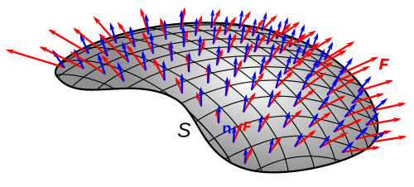
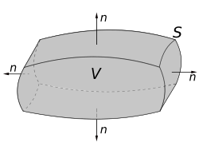
3D Vector Calculus
Flux of a vector field:
$$\iint_{S}{\overset{⃑}{F}⋅\overset{⃑}{n} dA}$$
Example: mass flux $\iint_{S}{ρ\left(\overset{⃑}{x}, t\right)\overset{⃑}{u}\left(\overset{⃑}{x}, t\right)⋅\overset{⃑}{n} dA}$
Gauss’s Divergence Theorem:
$$∯_{S}{\overset{⃑}{F}⋅\overset{⃑}{n} dA}=\iiint_{V}{∇⋅\overset{⃑}{F} dV}$$
Interpretation: divergence is the “source” of the flow

Slide 29
1D vs 3D
Velocity | $$u\left(x, t\right)$$ | $$\overset{⃑}{u}\left(\overset{⃑}{x}, t\right)$$
Mass Density | $$ρ\left(x, t\right)$$ | $$ρ\left(\overset{⃑}{x}, t\right)$$
Mass Flux | $$ρ\left(x, t\right)u\left(x, t\right)$$ | $$\iint_{S}{ρ\left(\overset{⃑}{x}, t\right)\overset{⃑}{u}\left(\overset{⃑}{x}, t\right)⋅\overset{⃑}{n}}dA$$
Mass Source | $$s\left(x, t\right)=\frac{∂ρ}{∂t}+\frac{∂}{∂x}\left(ρu\right)$$ | $$s\left(\overset{⃑}{x}, t\right)=\frac{∂ρ}{∂t}+∇⋅\left(ρ\overset{⃑}{u}\right)$$
Divergence Theorem | $$\int_{a}^{b}{\frac{dF}{dx}\left(x\right)dx}=F\left(b\right)−F\left(a\right)$$ | $$\iiint_{Ω}{∇⋅\overset{⃑}{F} dV}=∯_{∂Ω}{\overset{⃑}{F}⋅\overset{⃑}{n} dA}$$
Material Derivative | $$\frac{D}{Dt}φ\left(x, t\right)=\frac{∂φ}{∂t}+u\frac{∂φ}{∂x}$$ | $$\frac{D}{Dt}φ\left(\overset{⃑}{x}, t\right)=\frac{∂φ}{∂t}+\left(\overset{⃑}{u}⋅∇\right)φ$$
Acceleration | $$\frac{D}{Dt}u\left(x, t\right)=\frac{∂u}{∂t}+u\frac{∂u}{∂x}$$ | $$\frac{D}{Dt}\overset{⃑}{u}\left(\overset{⃑}{x}, t\right)=\frac{∂\overset{⃑}{u}}{∂t}+\left(\overset{⃑}{u}⋅∇\right)\overset{⃑}{u}$$

Slide 30
The Navier-Stokes Equations
External force
Conservation of momentum:
$$\frac{∂\overset{⃑}{u}}{∂t}=−\left(\overset{⃑}{u}⋅∇\right)\overset{⃑}{u}−\frac{1}{ρ}∇p+νΔ\overset{⃑}{u}+\overset{⃑}{f}$$
Incompressibility condition (conservation of mass):
$$∇⋅\overset{⃑}{u}=0$$
$p=p\left(\overset{⃑}{x}, t\right)$: pressure, a scalar field, unknown
$ν≥0$: kinematic viscosity, constant
$\overset{⃑}{f}$= $\overset{⃑}{f}\left(\overset{⃑}{x}, t\right)$: external force per unit mass, known
Diffusion
Advection
Pressure

Slide 31
The Navier-Stokes Equations
Conservation of momentum:
$$\frac{∂\overset{⃑}{u}}{∂t}=−\left(\overset{⃑}{u}⋅∇\right)\overset{⃑}{u}−\frac{1}{ρ}∇p+νΔ\overset{⃑}{u}+\overset{⃑}{f}$$
Incompressibility condition (conservation of mass):
$$∇⋅\overset{⃑}{u}=0$$
$p=p\left(\overset{⃑}{x}, t\right)$: pressure, a scalar field, unknown
$ν≥0$: kinematic viscosity, constant
$\overset{⃑}{f}$= $\overset{⃑}{f}\left(\overset{⃑}{x}, t\right)$: external force per unit mass, known
N-S equations are a system of 4 PDEs with 4 unknowns

Slide 32
N-S Equations vs Particle EoM
Navier-Stokes:
$$\frac{∂\overset{⃑}{u}}{∂t}+\left(\overset{⃑}{u}⋅∇\right)\overset{⃑}{u}=−\frac{1}{ρ}∇p+νΔ\overset{⃑}{u}+\overset{⃑}{f}$$
EoM of a Lagrangian particle:
$$m\frac{d^{2}\overset{⃑}{x}}{dt^{2}}={\overset{⃑}{f}}_{int}+{\overset{⃑}{f}}_{damping}+{\overset{⃑}{f}}_{ext}$$
Notes:
Differences:
PDEs vs ODEs
First-order vs second order
Advection term
Incompressibility condition

Slide 33
Stable Fluids
Paper: Jos Stam. Stable Fluids. SIGGRAPH 1999
Cited by 2677
Key Features:
Grid-based discretization
Projection operator based on Helmholz-Hodge decomposition
Operator splitting scheme
Semi-Lagrangian advection step (unconditionally stable)

Slide 34
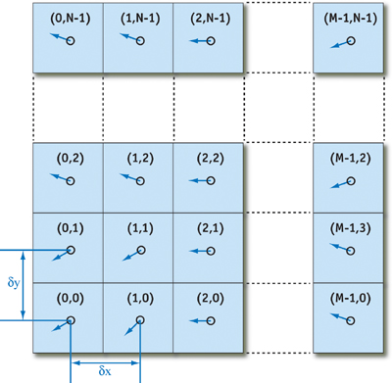
Grid Based Discretization
A 3D grid consists of $N×N×N$ grid points with uniform space $Δx$
A scalar field $φ\left(\overset{⃑}{x}, t\right)$ at a specific time $t$ is discretized as $N×N×N$ scalars
A vector field $\overset{⃑}{F}\left(\overset{⃑}{x}, t\right)$ at a specific time $t$ is discretized as $N×N×N$ vectors
Use trilinear interpolation if one needs to access a quantity off the grid point

Slide 35
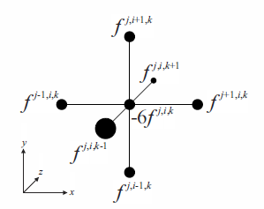
Grid Based Discretization
Finite difference formula for gradient
$∇f^{i, j, k}=\frac{1}{Δx}\left(\begin{matrix}f^{i+1, j, k}−f^{i, j, k} \\ f^{i, j+1, k}−f^{i, j, k} \\ f^{i, j, k+1}−f^{i, j, k}\end{matrix}\right)+𝒪\left(Δx\right)$ (Forward finite difference)
$∇f^{i, j, k}=\frac{1}{2Δx}\left(\begin{matrix}f^{i+1, j, k}−f^{i−1, j, k} \\ f^{i, j+1, k}−f^{i, j−1, k} \\ f^{i, j, k+1}−f^{i, j, k−1}\end{matrix}\right)+𝒪\left(Δx^{2}\right)$ (Central finite difference)

Slide 36
Grid Based Discretization
Finite difference formula for Laplacian
$Δf^{i, j, k}=$
$$\frac{f^{i+1, j, k}+f^{i−1, j, k}+f^{i, j+1, k}+f^{i, j−1, k}+f^{i, j, k+1}+f^{i, j, k−1}−6f^{i, j, k}}{Δx^{2}}+𝒪\left(Δx^{2}\right)$$

Slide 37
Idea: Elimination of Unknown $p\left(\overset{⃑}{x}, t\right)$
Navier-Stokes equations of incompressible flow:
$$\frac{∂\overset{⃑}{u}}{∂t}=−\left(\overset{⃑}{u}⋅∇\right)\overset{⃑}{u}−\frac{1}{ρ}∇p+νΔ\overset{⃑}{u}+\overset{⃑}{f}$$
$$∇⋅\overset{⃑}{u}=0$$
Target: eliminate the unknown $p\left(\overset{⃑}{x}, t\right)$
Observation: $p\left(\overset{⃑}{x}, t\right)$ only appears as $∇p$, a gradient field
Recall: gradient field is curl free; curl field is divergence free
Idea: Can we define some kind of decomposition to eliminate $∇p$

Slide 38
Idea: Elimination of Unknown $p\left(\overset{⃑}{x}, t\right)$
Helmholz-Hodge decomposition
$$\overset{⃑}{F}=∇×\overset{⃑}{A}+∇φ$$
Decompose any vector field into a curl part and a gradient part
How to construct
Solve the Laplacian equation to obtain $φ$:
$$Δφ=∇⋅\overset{⃑}{F}$$
The remaining part $\overset{⃑}{F}−∇φ$ is divergence free, it must be a curl field

Slide 39
Idea: Elimination of Unknown $p\left(\overset{⃑}{x}, t\right)$
Divergence-free projection operator
$$P: \overset{⃑}{F}↦∇×\overset{⃑}{A}=\overset{⃑}{F}−∇φ$$
$∇⋅\left(P\left(\overset{⃑}{F}\right)\right)=0$
$P\left(∇p\right)=0$
Apply to the equation of momentum:
$$\frac{∂\overset{⃑}{u}}{∂t}=−\left(\overset{⃑}{u}⋅∇\right)\overset{⃑}{u}−\frac{1}{ρ}∇p+νΔ\overset{⃑}{u}+\overset{⃑}{f}$$
$$⇒\frac{∂\overset{⃑}{u}}{∂t}=P\left(\frac{∂\overset{⃑}{u}}{∂t}\right)=P\left(−\left(\overset{⃑}{u}⋅∇\right)\overset{⃑}{u}+νΔ\overset{⃑}{u}+\overset{⃑}{f}\right)$$

Slide 40
Idea: Operator Splitting
Instead of solving:
$$\frac{d\overset{⃑}{u}}{dt}=A\left(\overset{⃑}{u}\right)+B\left(\overset{⃑}{u}\right)$$
We solve:
First: $\frac{d\overset{⃑}{u}}{dt}=A\left(\overset{⃑}{u}\right)$, then: $\frac{d\overset{⃑}{u}}{dt}=B\left(\overset{⃑}{u}\right)$
Justification:
$$e^{Δt\left(A+B\right)}=e^{ΔtA}e^{ΔtB}+𝒪\left(Δt^{2}\right)$$

Slide 41
Idea: Operator Splitting
Applied to Navier-Stokes equations:
$$\frac{∂\overset{⃑}{u}}{∂t}=P\left(−\left(\overset{⃑}{u}⋅∇\right)\overset{⃑}{u}+νΔ\overset{⃑}{u}+\overset{⃑}{f}\right)$$
$$=$$
$$=$$
$$\overset{⃑}{u}\left(\overset{⃑}{x}, t\right)$$
$$\overset{⃑}{u}\left(\overset{⃑}{x}, t+Δt\right)$$

Slide 42
Step 1: Add Force
$$\frac{∂\overset{⃑}{u}}{∂t}=\overset{⃑}{f}$$
Do a simple forward Euler step
$$\overset{⃑}{w_{1}}\left(\overset{⃑}{x}\right)=\overset{⃑}{w_{0}}\left(\overset{⃑}{x}\right)+\overset{⃑}{f}\left(\overset{⃑}{x}, t\right)Δt$$
In grid discretization
$${\overset{⃑}{w_{1}}}^{i, j, k}={\overset{⃑}{w_{1}}}^{i, j, k}+{\overset{⃑}{f}}^{i, j, k}Δt$$

Slide 43
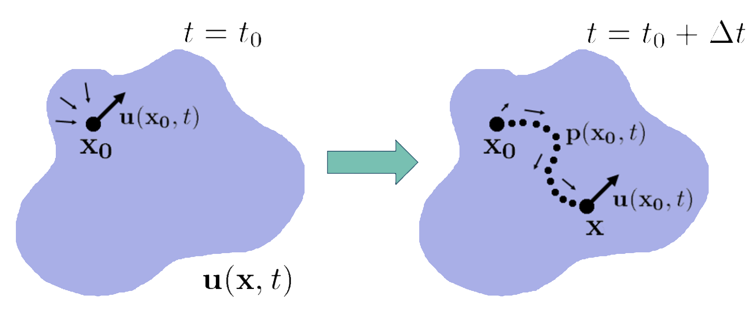
Step 2: Advection
$$\frac{∂\overset{⃑}{u}}{∂t}=−\left(\overset{⃑}{u}⋅∇\right)\overset{⃑}{u}$$
This is equivalent to $\frac{D\overset{⃑}{u}}{Dt}=\frac{∂\overset{⃑}{u}}{∂t}+\left(\overset{⃑}{u}⋅∇\right)\overset{⃑}{u}=0$
Using forward/backward Euler will pose stability condition on $Δt$
Physical meaning: let it flow under given velocity field

Slide 44
Step 2: Advection
$$\frac{∂\overset{⃑}{u}}{∂t}=−\left(\overset{⃑}{u}⋅∇\right)\overset{⃑}{u}$$
Trace the flow backward:
$$\overset{⃑}{w_{2}}\left(\overset{⃑}{x}\right)=\overset{⃑}{w_{1}}\left(\overset{⃑}{p}\left(\overset{⃑}{x}, −Δt\right)\right)$$
Unconditionally Stable

Slide 45
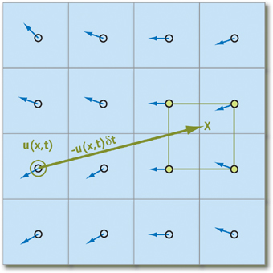
Step 2: Advection
$$\overset{⃑}{w_{2}}\left(\overset{⃑}{x}\right)=\overset{⃑}{w_{1}}\left(\overset{⃑}{p}\left(\overset{⃑}{x}, −Δt\right)\right)$$
Implementation:
$\overset{⃑}{p}\left(\overset{⃑}{x}, −Δt\right)≔\overset{⃑}{x}−\overset{⃑}{w_{1}}\left(\overset{⃑}{x}\right)Δt$
Trilinear interpolate $\overset{⃑}{w_{1}}$ to get $\overset{⃑}{w_{1}}\left(\overset{⃑}{p}\left(\overset{⃑}{x}, −Δt\right)\right)$
$\overset{⃑}{w_{2}}\left(\overset{⃑}{x}\right)←\overset{⃑}{w_{1}}\left(\overset{⃑}{p}\left(\overset{⃑}{x}, −Δt\right)\right)$

Slide 46
Step 3: Diffusion
$$\frac{∂\overset{⃑}{u}}{∂t}=νΔ\overset{⃑}{u}$$
Recall that
$Δf^{i, j, k}=$
$$\frac{f^{i+1, j, k}+f^{i−1, j, k}+f^{i, j+1, k}+f^{i, j−1, k}+f^{i, j, k+1}+f^{i, j, k−1}−6f^{i, j, k}}{Δx^{2}}+𝒪\left(Δx^{2}\right)$$
$$⇒ \left(\begin{aligned}\begin{matrix}\begin{aligned}⋮ \\ ⋮\end{aligned} \\ Δf^{i, j, k} \\ ⋮\end{matrix} \\ ⋮\end{aligned}\right)=L\left(\begin{matrix}\begin{aligned}⋮ \\ ⋮\end{aligned} \\ f^{i, j, k} \\ \begin{aligned}⋮ \\ ⋮\end{aligned}\end{matrix}\right), L∈ℝ^{N^{3}×N^{3}}$$

Slide 47
Step 3: Diffusion
$$\frac{∂\overset{⃑}{u}}{∂t}=νΔ\overset{⃑}{u}$$
Laplacian matrix $L$
Symmetric, sparse (only $7×N^{3}$ non-zero entries)
$−L$ is positive semi-definite
$$−{\left(\begin{aligned}\begin{matrix}\begin{aligned}⋮ \\ ⋮\end{aligned} \\ f^{i, j, k} \\ ⋮\end{matrix} \\ ⋮\end{aligned}\right)}^{T}L\left(\begin{matrix}\begin{aligned}⋮ \\ ⋮\end{aligned} \\ f^{i, j, k} \\ \begin{aligned}⋮ \\ ⋮\end{aligned}\end{matrix}\right)=\sum_{i, j, k}{{\left(f^{i+1, j, k}−f^{i, j, k}\right)}^{2}+{\left(f^{i, j+1, k}−f^{i, j, k}\right)}^{2}+{\left(f^{i, j, k+1}−f^{i, j, k}\right)}^{2}}≥0$$

Slide 48
Step 3: Diffusion
$$\frac{∂\overset{⃑}{u}}{∂t}=νΔ\overset{⃑}{u}$$
Solve using backward Euler:
$$\frac{\overset{⃑}{w_{3}}−\overset{⃑}{w_{2}}}{Δt}=νL\overset{⃑}{w_{3}}, \overset{⃑}{w_{2}}, \overset{⃑}{w_{3}}∈ℝ^{N^{3}×3}$$
$$⟺ \left(I−νΔt L\right) \overset{⃑}{w_{3}}=\overset{⃑}{w_{2}}$$
$$⟺ \overset{⃑}{w_{3}}={\left(I−νΔt L\right)}^{−1}\overset{⃑}{w_{2}}$$

Slide 49
Step 4: Projection
$$\overset{⃑}{w_{4}}=P\left(\overset{⃑}{w_{3}}\right)$$
Helmholz-Hodge decomposition
$$\overset{⃑}{w_{3}}=∇×\overset{⃑}{A}+∇φ$$
Solve $Δφ=∇⋅\overset{⃑}{w_{3}}$
${\left(∇⋅\overset{⃑}{w_{3}}\right)}^{i, j, k}=\frac{w_{3x}^{i+1, j, k}−w_{3x}^{i−1, j, k}+w_{3y}^{i, j+1, k}−w_{3y}^{i, j−1, k}+w_{3z}^{i, j, k+1}−w_{3z}^{i, j, k−1}}{2Δx}$
$\left(φ^{i, j, k}\right)=L^{−1}\left({\left(∇⋅\overset{⃑}{w_{3}}\right)}^{i, j, k}\right)$
Project $\overset{⃑}{w_{4}}=\overset{⃑}{w_{3}}−∇φ$
${\left(∇φ\right)}^{i, j, k}=\left(\begin{matrix}\frac{φ^{i+1, j, k}−φ^{i−1, j, k}}{2Δx} & \frac{φ^{i, j+1, k}−φ^{i, j−1, k}}{2Δx} & \frac{φ^{i, j, k+1}−φ^{i, j, k−1}}{2Δx}\end{matrix}\right)$

Slide 50
Periodic Boundaries
Periodic boundary condition:
$$\overset{⃑}{u}\left(x, y, z, t\right)=\overset{⃑}{u}\left(x+h, y, z, t\right)=\overset{⃑}{u}\left(x, y+h, z, t\right)=\overset{⃑}{u}\left(x, y, z+h, t\right)$$
Fourier transform
$$\overset{⃑}{u}\left(\overset{⃑}{x}, t\right)⟶\hat{\overset{⃑}{u}}\left(\overset{⃑}{k}, t\right)$$
$$∇⋅\overset{⃑}{u}\left(\overset{⃑}{x}, t\right)⟶i\overset{⃑}{k}⋅\hat{\overset{⃑}{u}}\left(\overset{⃑}{k}, t\right)$$
$$Δ\overset{⃑}{u}\left(\overset{⃑}{x}, t\right)⟶{\left|\overset{⃑}{k}\right|}^{2}\hat{\overset{⃑}{u}}\left(\overset{⃑}{k}, t\right)$$
$$P\overset{⃑}{u}\left(\overset{⃑}{x}, t\right)⟶\hat{\overset{⃑}{u}}\left(\overset{⃑}{k}, t\right)−\frac{\hat{\overset{⃑}{u}}⋅\overset{⃑}{k}}{{\left|\overset{⃑}{k}\right|}^{2}}\overset{⃑}{k}$$

Slide 51
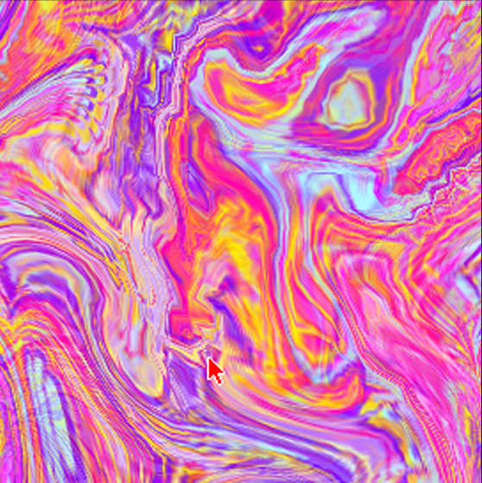
Periodic Boundaries

Slide 52
Diffusing Substances
Scalar quantity $φ\left(\overset{⃑}{x}, t\right)$ (e.g. color, texture coordinate, temperature, etc.)
Convection-diffusion equation
$$\frac{∂φ}{∂t}=−\overset{⃑}{u}⋅∇φ+kΔφ−dφ+S$$
$k$: diffusion constant
$d$: dissipation rate
$S$: source term

Slide 53
References
Jos Stam. Stable Fluids. SIGGRAPH 1999
Chapter 38. Fast Fluid Dynamics Simulation on the GPU | NVIDIA Developer
Further reading:
Ronald Fedkiw et.al. Visual Simulation of Smoke. SIGGRAPH 2001
Yongning Zhu, Robert Bridson. Animating Sand as a Fluid. SIGGRAPH 2005
Tyson Brochu et.al. Linear-Time Smoke Animation with Vortex Sheet Meshes. SCA 2012.
Alexey Stomakhin et.al. A material point method for snow simulation. SIGGRAPH 2013.
Fang Da et.al. Surface-Only Liquids. SIGGRAPH 2016
Notes:
Shortcomings of stable fluids:
Although it is stable, advection introduce damping, lose accuracy
Detailed simulation requires a large grid
Tracking surface is difficult
Bad for fluid-solid interaction
Modern approach: hybrid

