Slide 1
Kirchhoff-Love Shells with Arbitrary Hyperelastic Materials Jiahao Wen, University of Southern California Jernej Barbič, University of Southern California

Slide 2
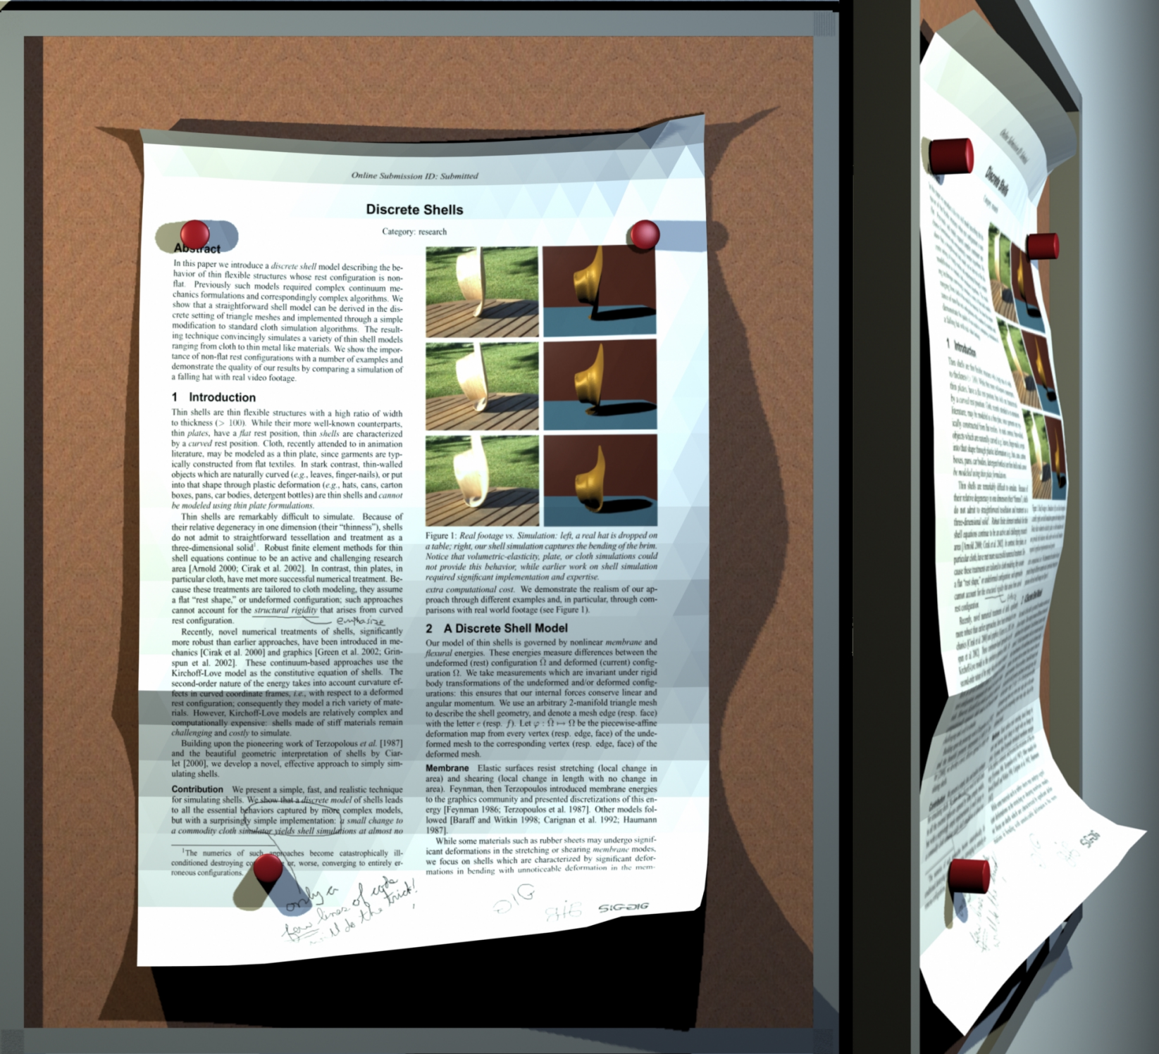
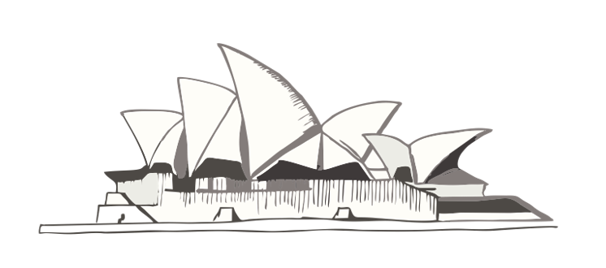
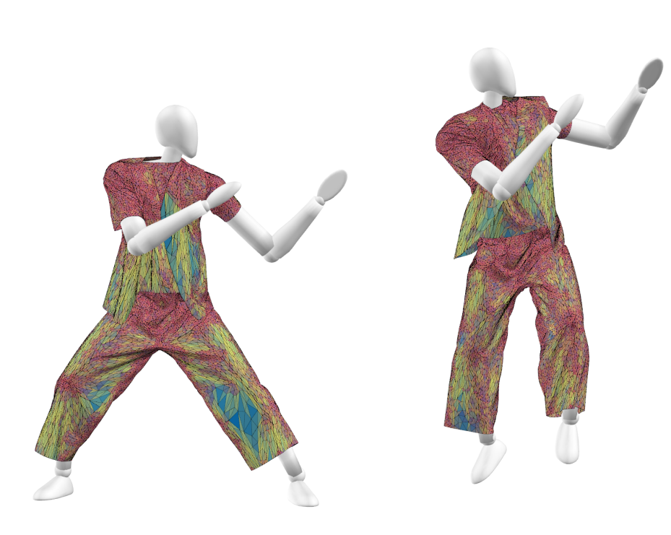
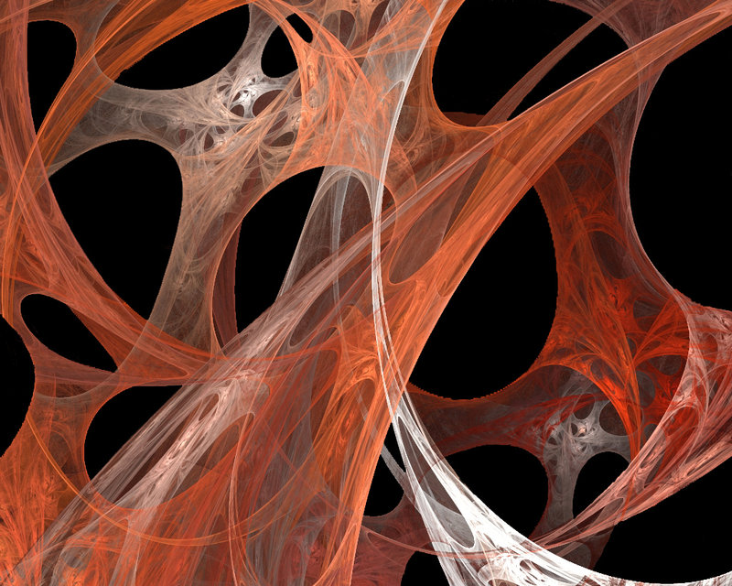
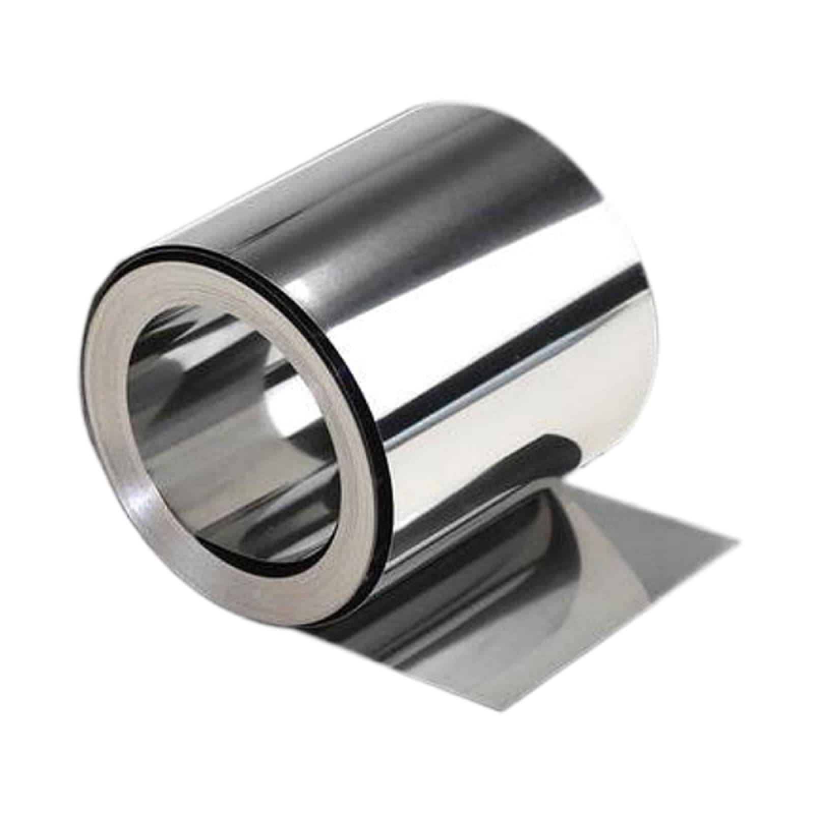
Thin shells
Architecture (roof)
Parachutes
Paper [Grinspun et al. 2003]
Biological membranes (fascia)
Metal sheets
Cloth [Narain et al. 2012]

Slide 3
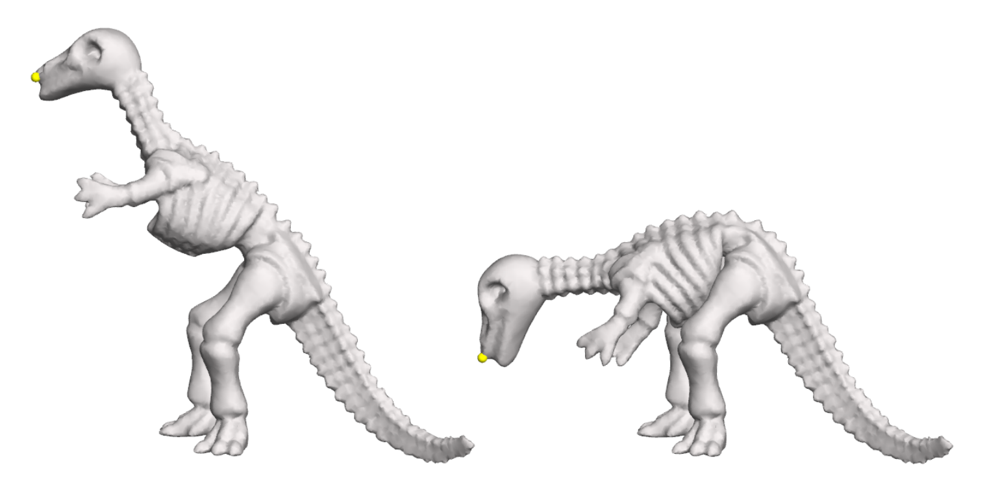
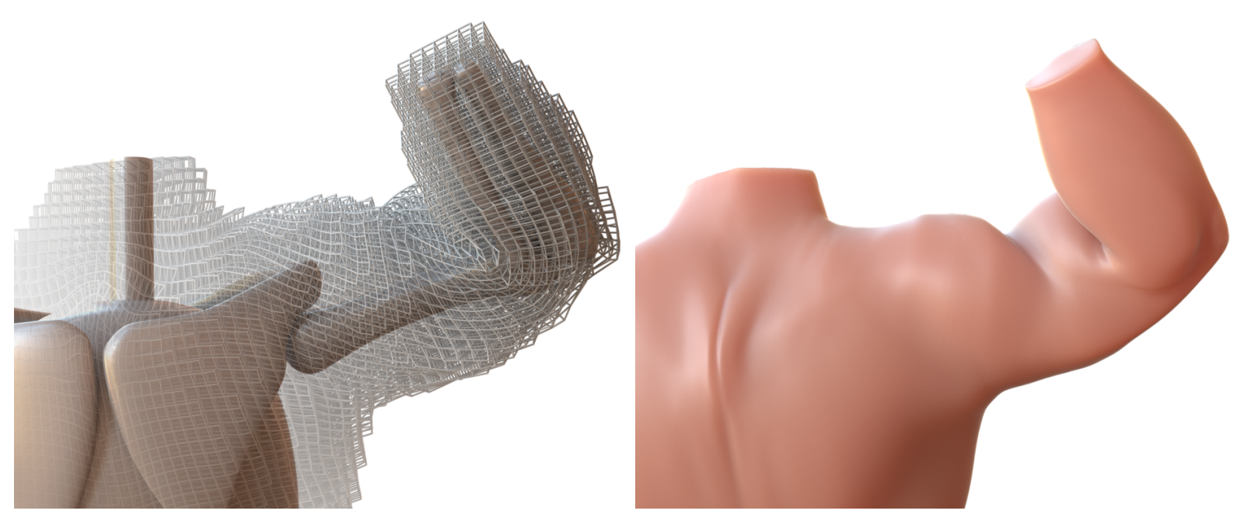
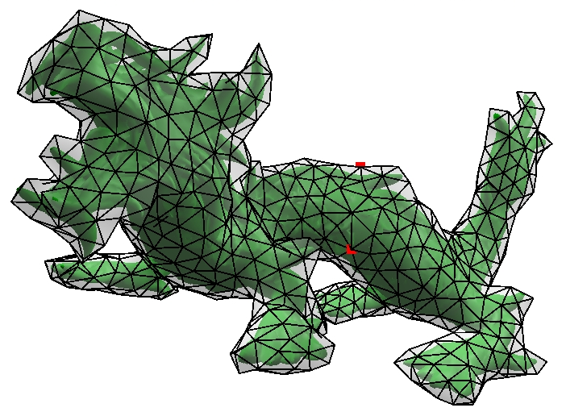
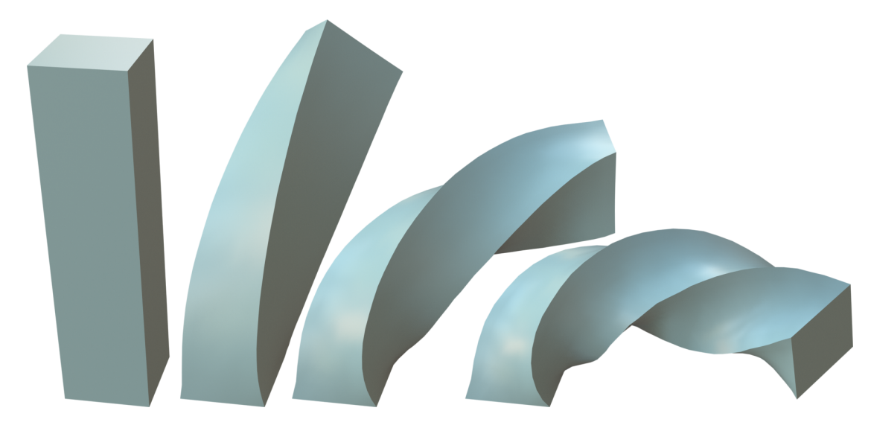
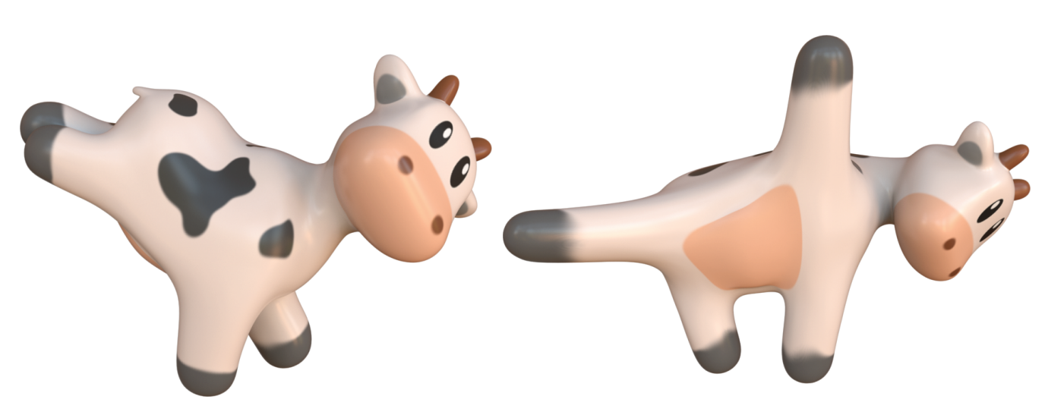
Hyperelastic volumetric materials
ARAP
[Sorkine et al. 2007]
Stable Neo-Hookean
[Smith et al. 2018]
STVK
[Barbič et al. 2012]
Symmetric Dirichlet
[Smith et al. 2019]
Symmetric ARAP
[Smith et al. 2019]

Slide 4
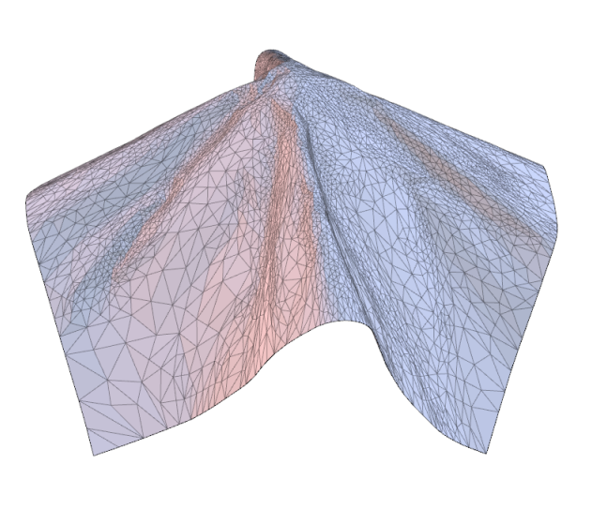
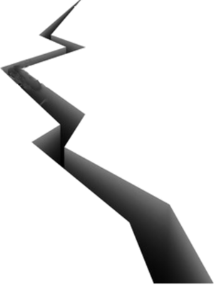
Problem
Thin shell simulation
Volumetric simulation
A thin shell is simply a very thin volumetric object.
The thickness is close to 0, but not 0!
Can we use 3D solid mechanics and volumetric hyperelastic materials to simulate thin shells? 🤔

Slide 5
We contribute such a method…
We expand the volumetric elastic energy to a Taylor series in the thickness $h$.
$$h→0$$
$$3D→2D$$
Our formulation works for arbitrary hyperelastic materials, arbitrary thin-shell rest shapes, and arbitrarily large deformations.

Slide 6
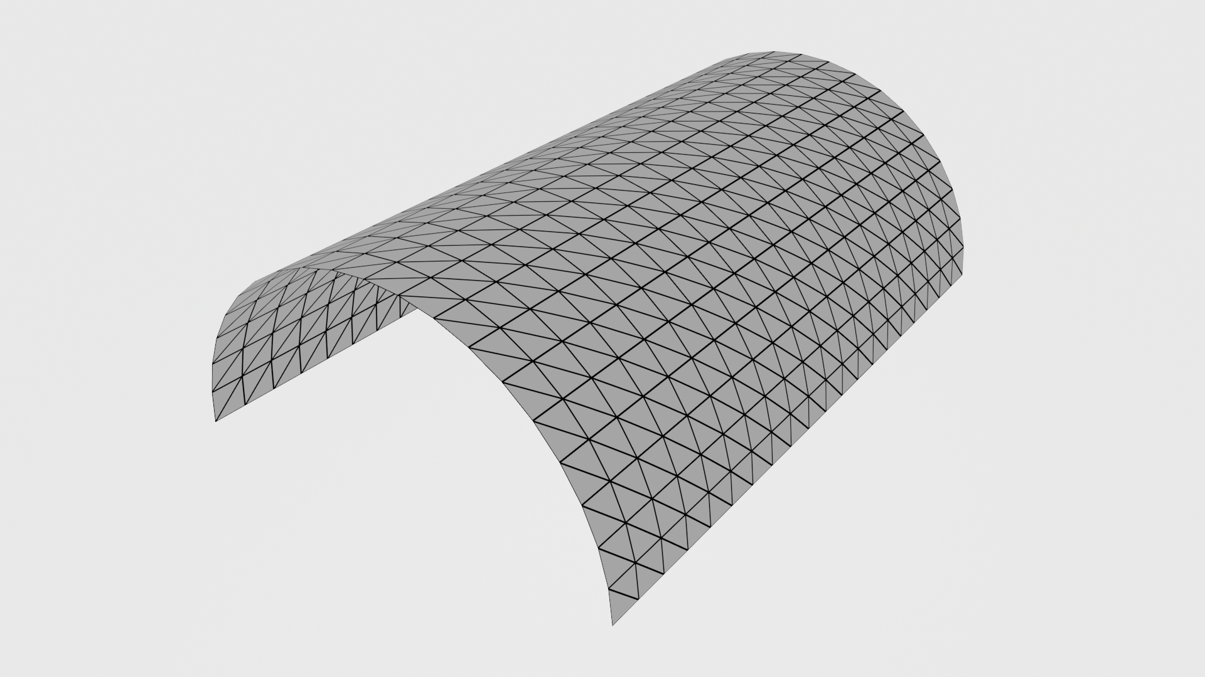
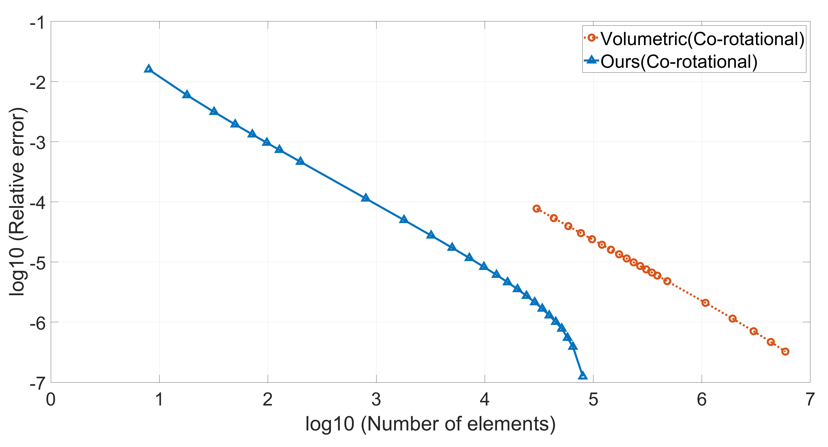
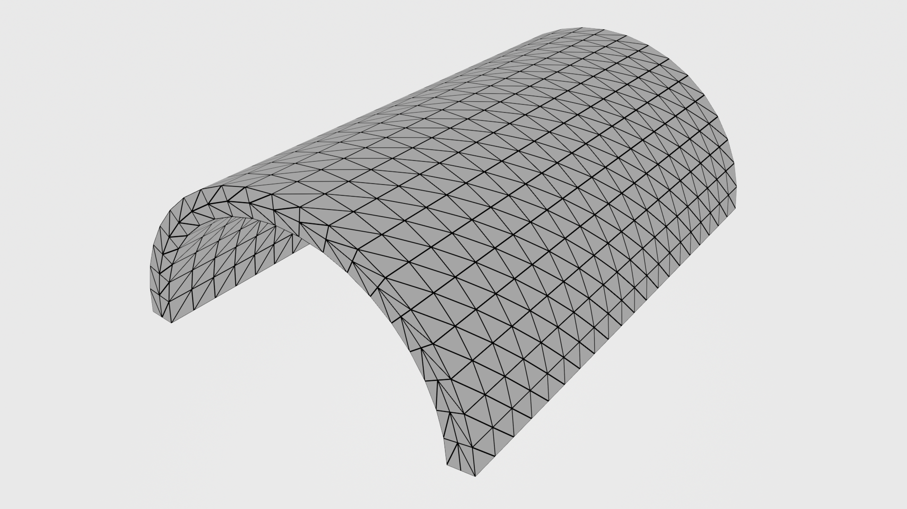
Better convergence to analytical result
Why not simulate a volumetric thin shell directly using a volumetric mesh?🤔
Triangle mesh
extrude up and down
Tet mesh
Ours
Tet mesh

Slide 7
Visual comparison to volumetric simulation

Slide 8
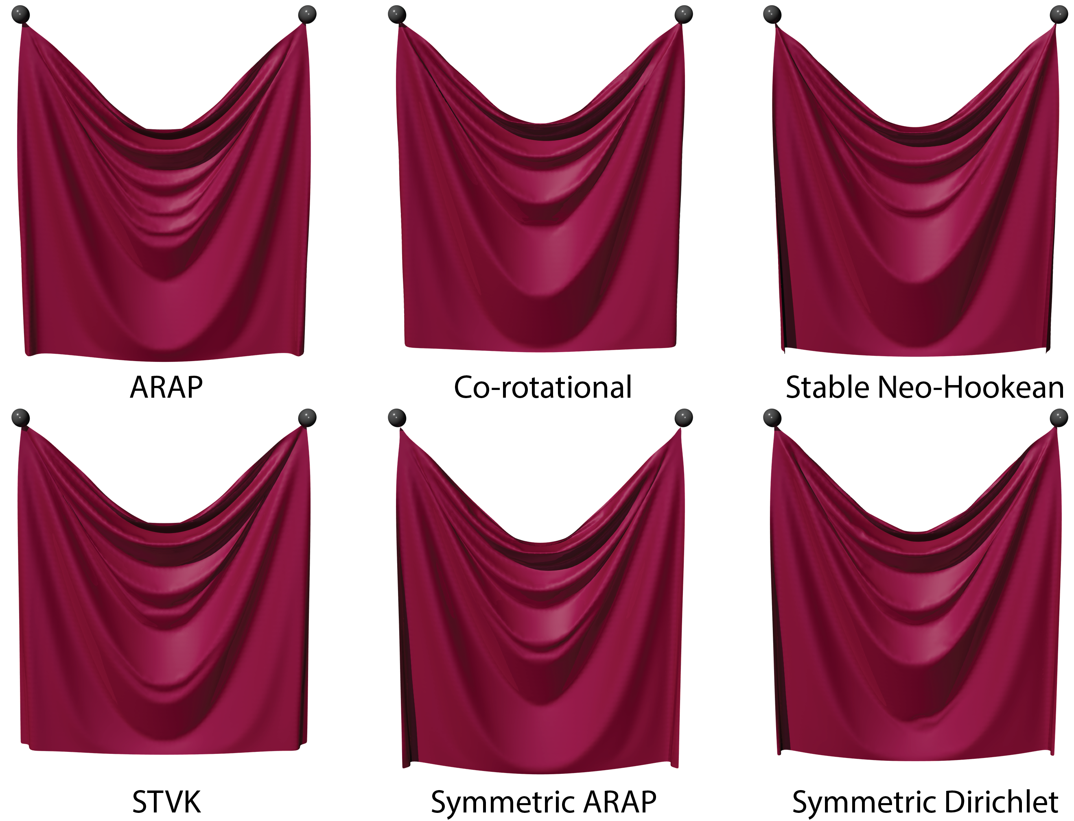
Benefits
We can simply “plug in” any volumetric hyperelastic materials and simulate “Co-rotational cloth”, “ARAP cloth”, etc.

Slide 9
Benefits
We can simply “plug in” any volumetric hyperelastic materials and simulate “Co-rotational cloth”, “ARAP cloth”, etc.

Slide 10
SPD projection
Many simulation techniques have been designed to benefit volumetric simulation.
They can now be applied to thin shells.

Slide 11
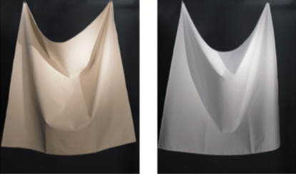
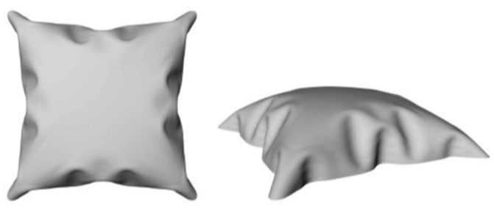
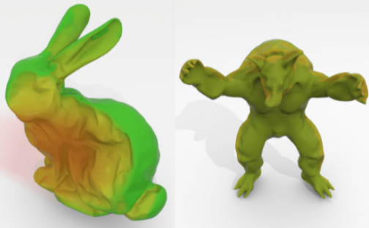
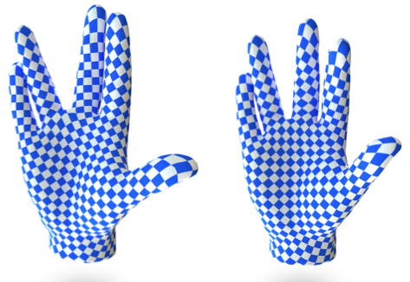
Related work
[Cirak et al. 2001]
[Clyde et al. 2017]
[Chen et al. 2018]
[Lin et al. 2022]

Slide 12
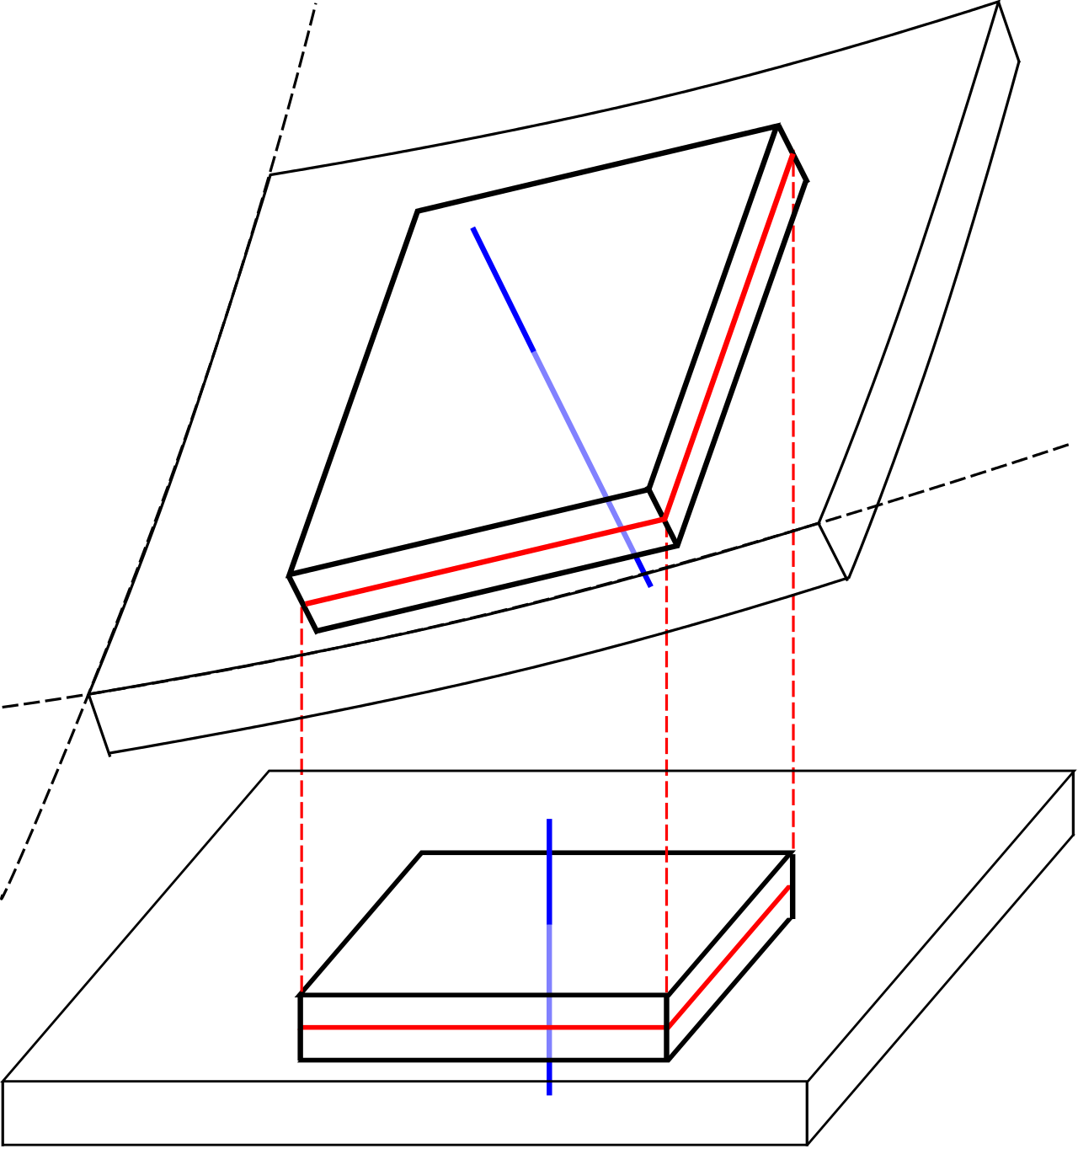
Kirchhoff-Love thin-shell assumption
deformed shape
Normal to mid-surface remains normal to mid-surface after deformation.
The thickness does not change during deformation.
The thickness is small relative to object size and curvature radius.
normal
Commonly used
Simplify problem
rest shape
mid-surface
[image source: Wikipedia]

Slide 13
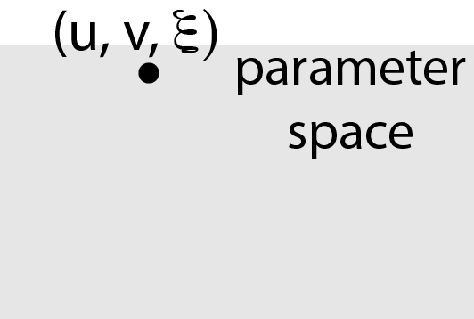
Parameterization
$$X\left(u,v,ξ\right)=Y\left(u,v\right)+ξN\left(u,v\right)$$
$$x\left(u,v,ξ\right)=y\left(u,v\right)+ξn(u,v)$$
13

Slide 14
3D Solid Deformation gradient
$$F=gG^{−1} \\ =(t+ξq) {(T+ξQ)}^{−1}$$
Difficult to compute for integration!
$T,t,Q,q$: defined in our paper
Applying Neumann series:
$$F=F_{0}+ξF_{1}+ξ^{2}F_{2}+O\left(ξ^{3}\right)$$
Bending happens because of non-zero thickness.
$F_{0},F_{1},F_{2}$ : defined in our paper
$F_{0}$ for stretching
$F_{1},F_{2}$ for bending

Slide 15
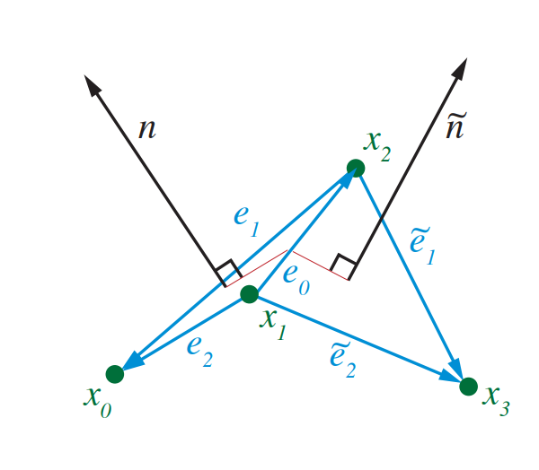
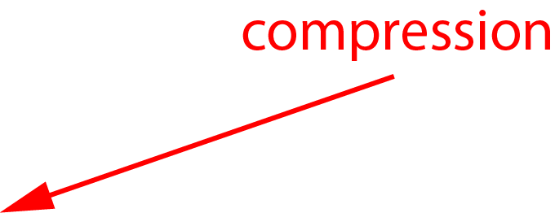
Intuitive explanation for bending
[Tamstorf et al. 2013]
🪄
Transverse view

Slide 16
Elastic energy density
$$F=F_{0}+ξF_{1}+ξ^{2}F_{2}+O\left(ξ^{3}\right)$$
$$ψ\left(F\right)=ψ\left(F_{0}\right)+ξ\left(P\left(F_{0}\right):F_{1}\right)+ξ^{2}\left(P\left(F_{0}\right):F_{2}+\frac{1}{2}\left(\left({\frac{dP}{dF}}_{|F=F_{0}}:F_{1}\right):F_{1}\right)\right)+O(ξ^{3})$$
$P$: the First Piola-Kirchhoff stress tensor
$F_{0}$, $F_{1}$, $F_{2}$: defined in the paper

Slide 17
Elastic energy
Integration: $E=\int_{Ω×[−h/2,h/2]}^{ }{ψ\left(F\right)dV}$
$$E=h\int_{Ω}^{ }{ψ\left(F_{0}\right)dS}+\frac{h^{3}}{12}\int_{Ω}^{ }{\left(P\left(F_{0}\right):\left(F_{2}−2HF_{1}\right)+\frac{1}{2}\left(\left({\frac{dP}{dF}}_{|F=F_{0}}:F_{1}\right):F_{1}\right)+Kψ\left(F_{0}\right)\right)dS}+O(h^{5})$$
$$E=h\int_{Ω}^{ }{ψ\left(F_{0}\right)dS}+\frac{h^{3}}{12}\int_{Ω}^{ }{\left(P\left(F_{0}\right):\left(F_{2}−2HF_{1}\right)+\frac{1}{2}\left(\left({\frac{dP}{dF}}_{|F=F_{0}}:F_{1}\right):F_{1}\right)+Kψ\left(F_{0}\right)\right)dS}+O(h^{5})$$
$$E=h\int_{Ω}^{ }{ψ\left(F_{0}\right)dS}+\frac{h^{3}}{12}\int_{Ω}^{ }{\left(P\left(F_{0}\right):\left(F_{2}−2HF_{1}\right)+\frac{1}{2}\left(\left({\frac{dP}{dF}}_{|F=F_{0}}:F_{1}\right):F_{1}\right)+Kψ\left(F_{0}\right)\right)dS}+O(h^{5})$$
$P$: the First Piola-Kirchhoff stress tensor $K$: rest Gauss curvature
$F_{0}$, $F_{1}$, $F_{2}$: defined in the paper
■: stretching
■: bending

Slide 18
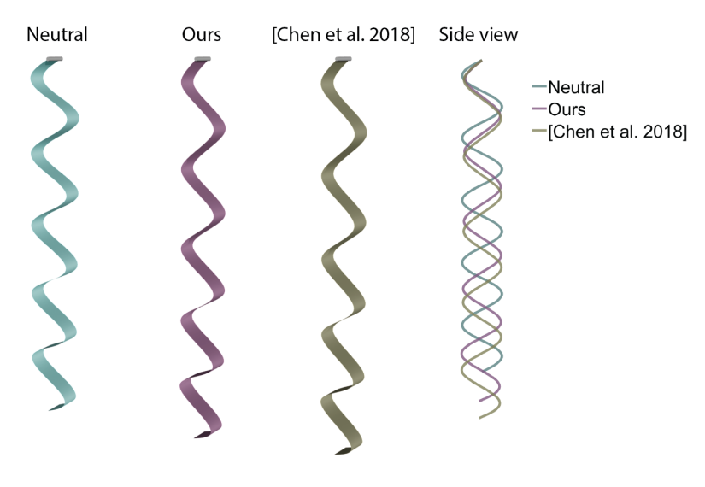
Generalization of [Chen et al. 2018]
Under the small in-plane stretch assumption in [Chen et al. 2018]
$$E_{Chen}=\frac{h}{4}{\left\|{\overline{a}}^{−1}a−I\right\|}_{SV}^{2}+\frac{h^{3}}{12}{\left\|{\overline{a}}^{−1}(b−\overline{b}) \right\|}_{SV}^{2}+O(h^{4})$$
$$E_{ours}=h\int_{Ω}^{ }{ψ\left(F_{0}\right)dS}+\frac{h^{3}}{12}\int_{Ω}^{ }{\left(P\left(F_{0}\right):\left(F_{2}−2HF_{1}\right)+\frac{1}{2}\left(\left({\frac{dP}{dF}}_{|F=F_{0}}:F_{1}\right):F_{1}\right)+Kψ\left(F_{0}\right)\right)dS}+O(h^{5})$$
Missing terms!
Missing terms!

Slide 19
Problem: $P, dP/dF$ should not appear in energy
This would make calculation of forces and stiffness matrices impractical. ☹️
$$E=h\int_{Ω}^{ }{ψ\left(F_{0}\right)dS}+\frac{h^{3}}{12}\int_{Ω}^{ }{\left(P\left(F_{0}\right):\left(F_{2}−2HF_{1}\right)+\frac{1}{2}\left(\left({\frac{dP}{dF}}_{|F=F_{0}}:F_{1}\right):F_{1}\right)+Kψ\left(F_{0}\right)\right)dS}+O(h^{5})$$
Solution: eliminate $P,\frac{dP}{dF}$ using finite differencing
$$E=h\int_{Ω}^{ }{\left(\frac{h^{2}K}{12}ψ\left(F_{0}\right)+ψ\left(F_{0}+\frac{h^{2}}{24}\left(F_{2}−2HF_{1}\right)\right)−ψ\left(F_{0}−\frac{h^{2}}{24}\left(F_{2}−2HF_{1}\right)\right)+\frac{1}{2}\left(ψ\left(F_{0}+\frac{\sqrt{3}}{6}hF_{1}\right)+ψ\left(F_{0}−\frac{\sqrt{3}}{6}hF_{1}\right)\right)\right)dS+O(h^{5})}$$
Still $O(h^{5})$, but no $P,\frac{dP}{dF}$ !!

Slide 20
F-Based energy vs. E-Based energy
Deformation gradient: $F$
Green strain tensor: $E=\frac{1}{2}\left(F^{T}F−I\right)$
$$ψ(F)$$
$$ψ\left(E\right)=ψ\left(\frac{1}{2}\left(F^{T}F−I\right)\right)$$
equivalent
More commonly
used in practice!
Our method can handle both F-based and E-based energies!
Our method benefits from existing F-based stability analyses.

Slide 21
Categorization of KL-shell energies
……
❓
……
Volumetric materials
Thin-shell materials
Q: For KL thin-shells, is it possible that two hyperelastic volumetric energies result in identical thin-shell energies?🤨

Slide 22
Categorization of KL-shell energies
Q: For KL thin-shells, is it possible that two hyperelastic volumetric energies result in identical thin-shell energies?🤨
A: $ψ_{1}$ and $ψ_{2}$ produce identical thin-shell energies iff they agree on each deformation gradient $F$ of the specific form
$$F=\left[\begin{matrix}∗ & ∗ & 0 \\ ∗ & ∗ & 0 \\ 0 & 0 & 1\end{matrix}\right]V^{T}$$
$V$: arbitrary $ℝ^{3×3}$ rotation matrix.
(see detailed proof in our paper 🤓)

Slide 23
Categorization of KL-shell energies
For isotropic materials
$$F=U\left[\begin{matrix}λ_{1} & & \\ & λ_{2} & \\ & & 1\end{matrix}\right]V^{T}$$
$$\left\|n\right\|=1$$
Isotropic KL materials
Symmetric energies of two principal stretches
$$ψ\left(λ_{1},λ_{2}\right)$$

Slide 24
Material design
The user can design KL thin-shell materials through symmetric functions
$$ψ\left(λ_{1},λ_{2}\right)$$
But the design is still tedious because the space of symmetric functions is large! 🤯
2D Valanis-Landel hypothesis
$$ψ\left(λ_{1},λ_{2}\right)=f\left(λ_{1}\right)+f\left(λ_{2}\right)+g(λ_{1}λ_{2})$$

Slide 25
3-parameter Valanis-Landel family
Simplest $f,g$ that permit controlling small strain and large strain behavior!
$$f\left(x\right)=\frac{1}{12}p{(x−1)}^{4}+\frac{1}{2}kx^{2}−kx+\frac{k}{2}$$
$$g\left(x\right)=\frac{1}{2}C{(x−1)}^{2}$$
$p,k,C$: scalar parameters tuned by users
Small deformation, same behavior.
Large deformation, higher $p$ has larger stiffness.

Slide 26
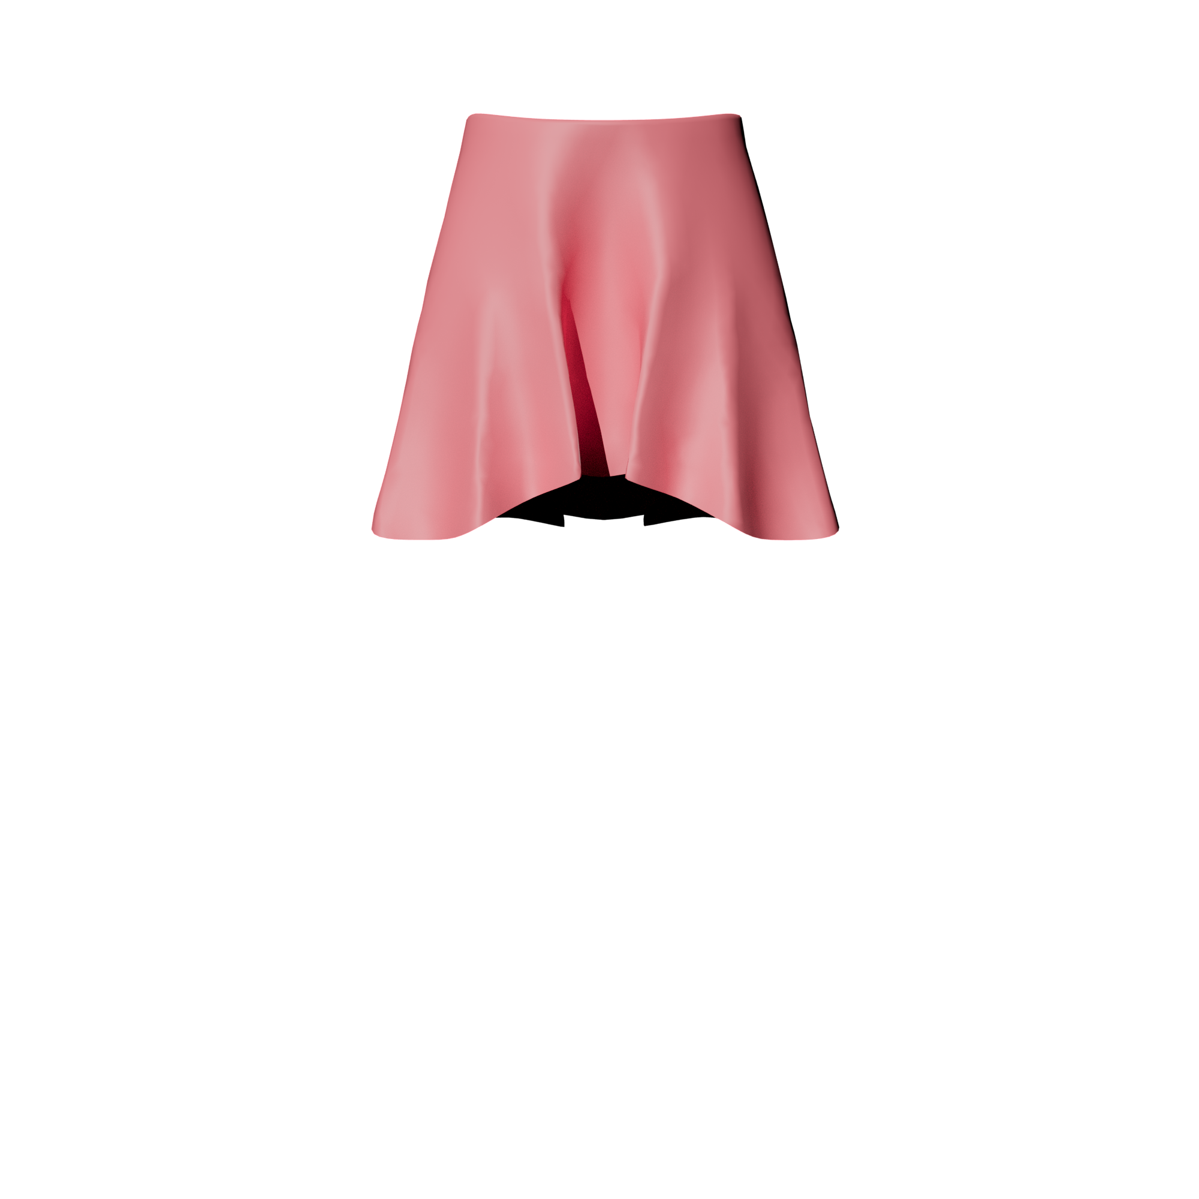
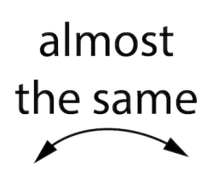
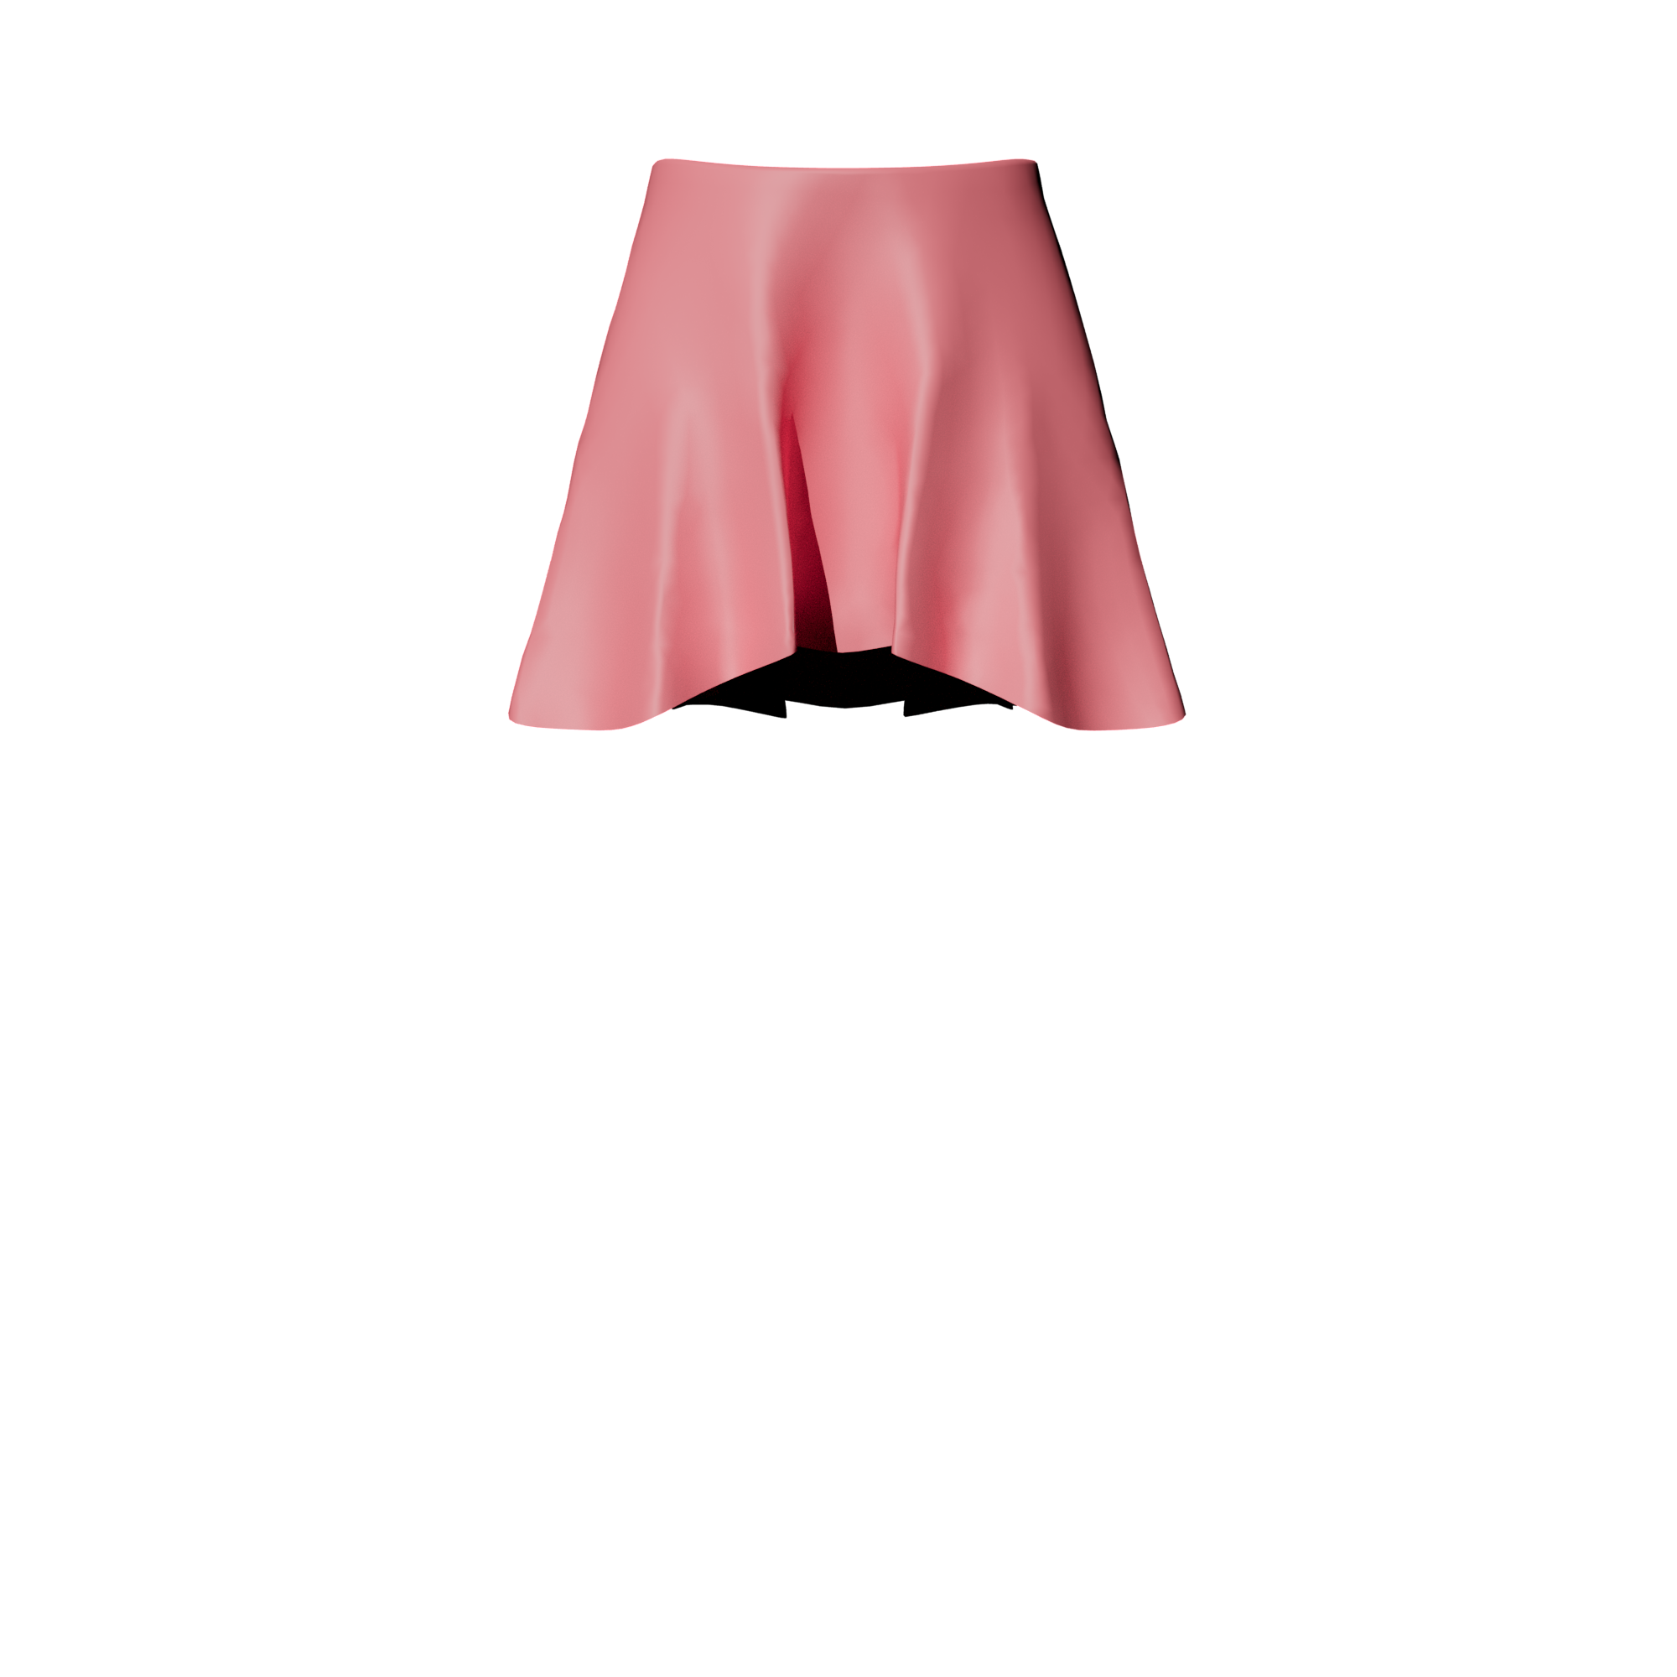
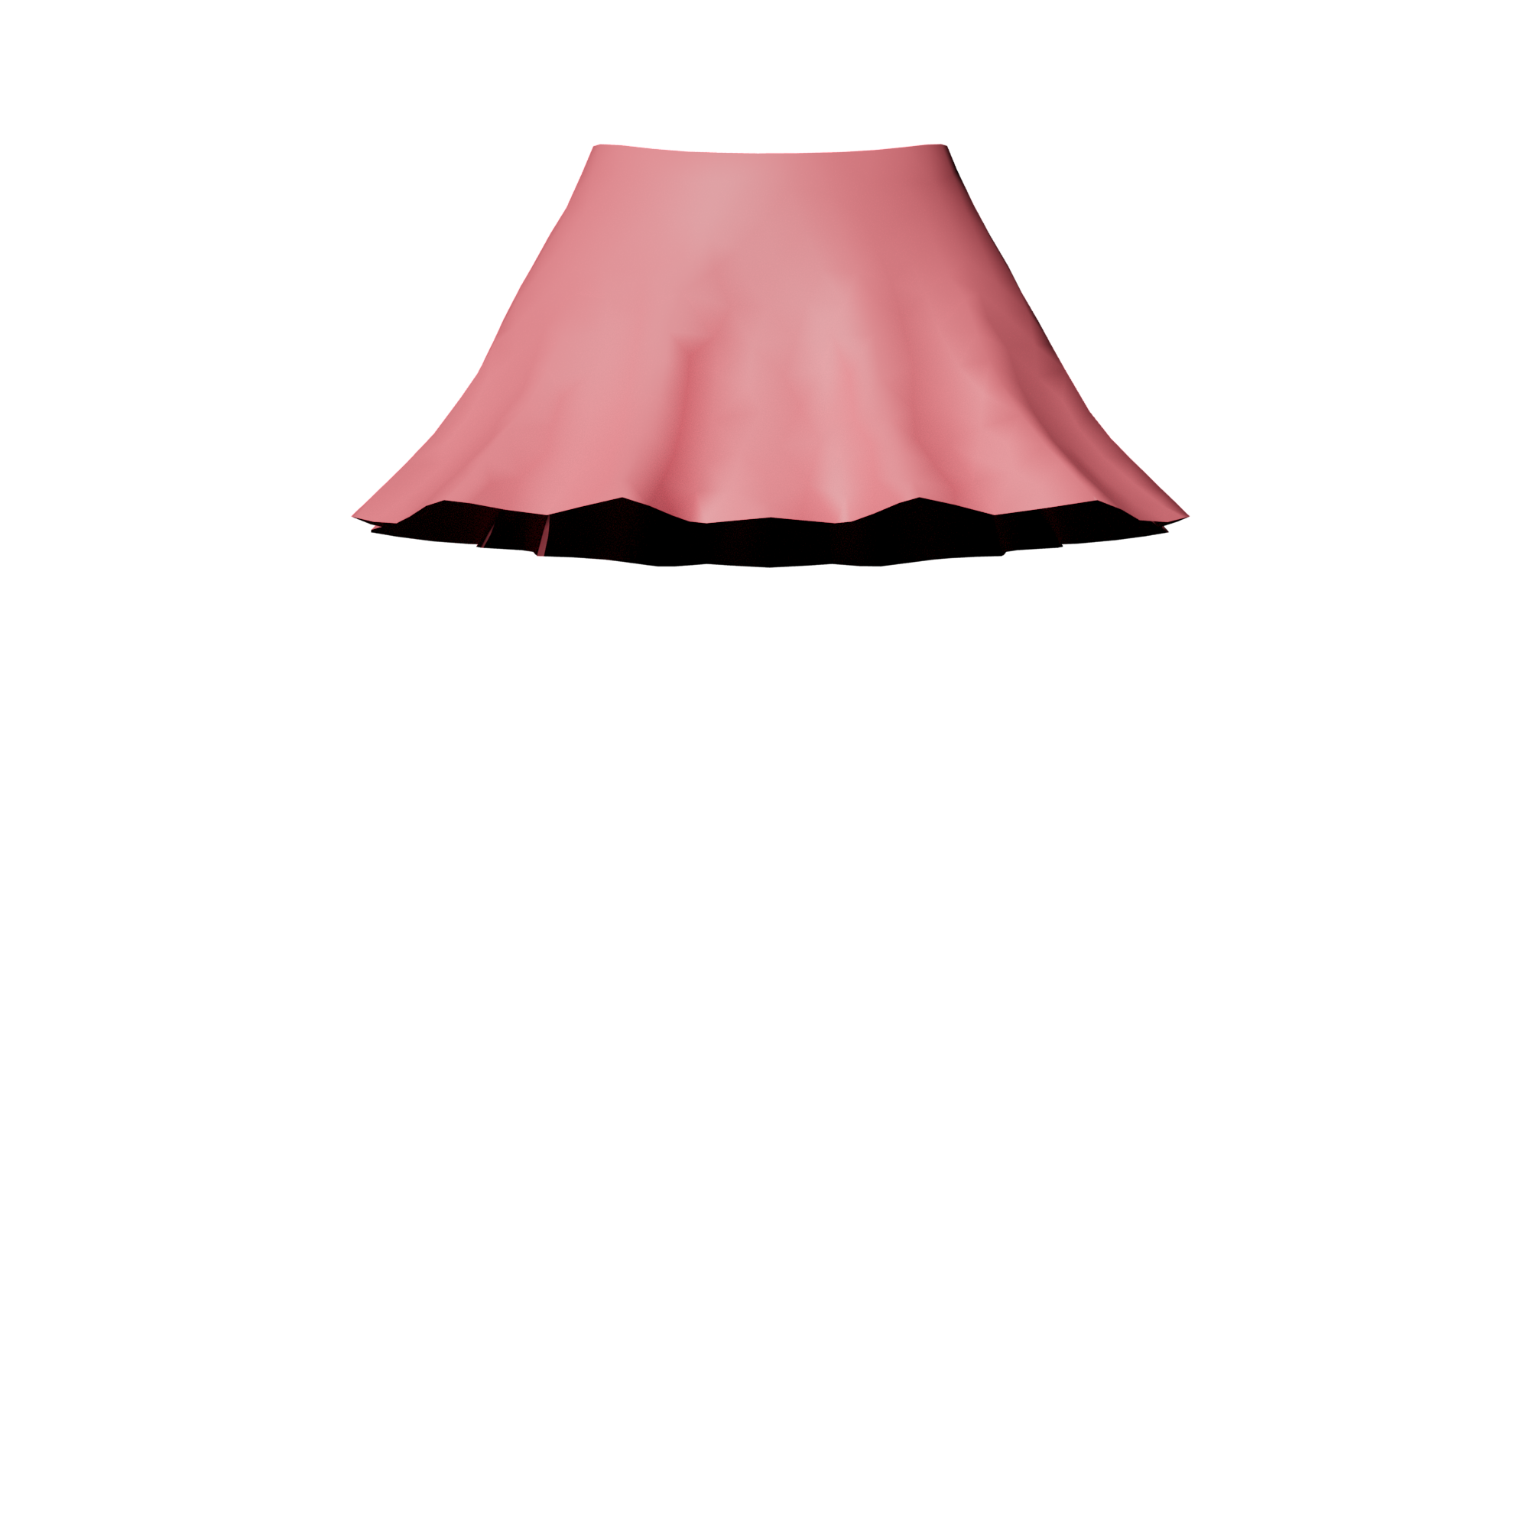
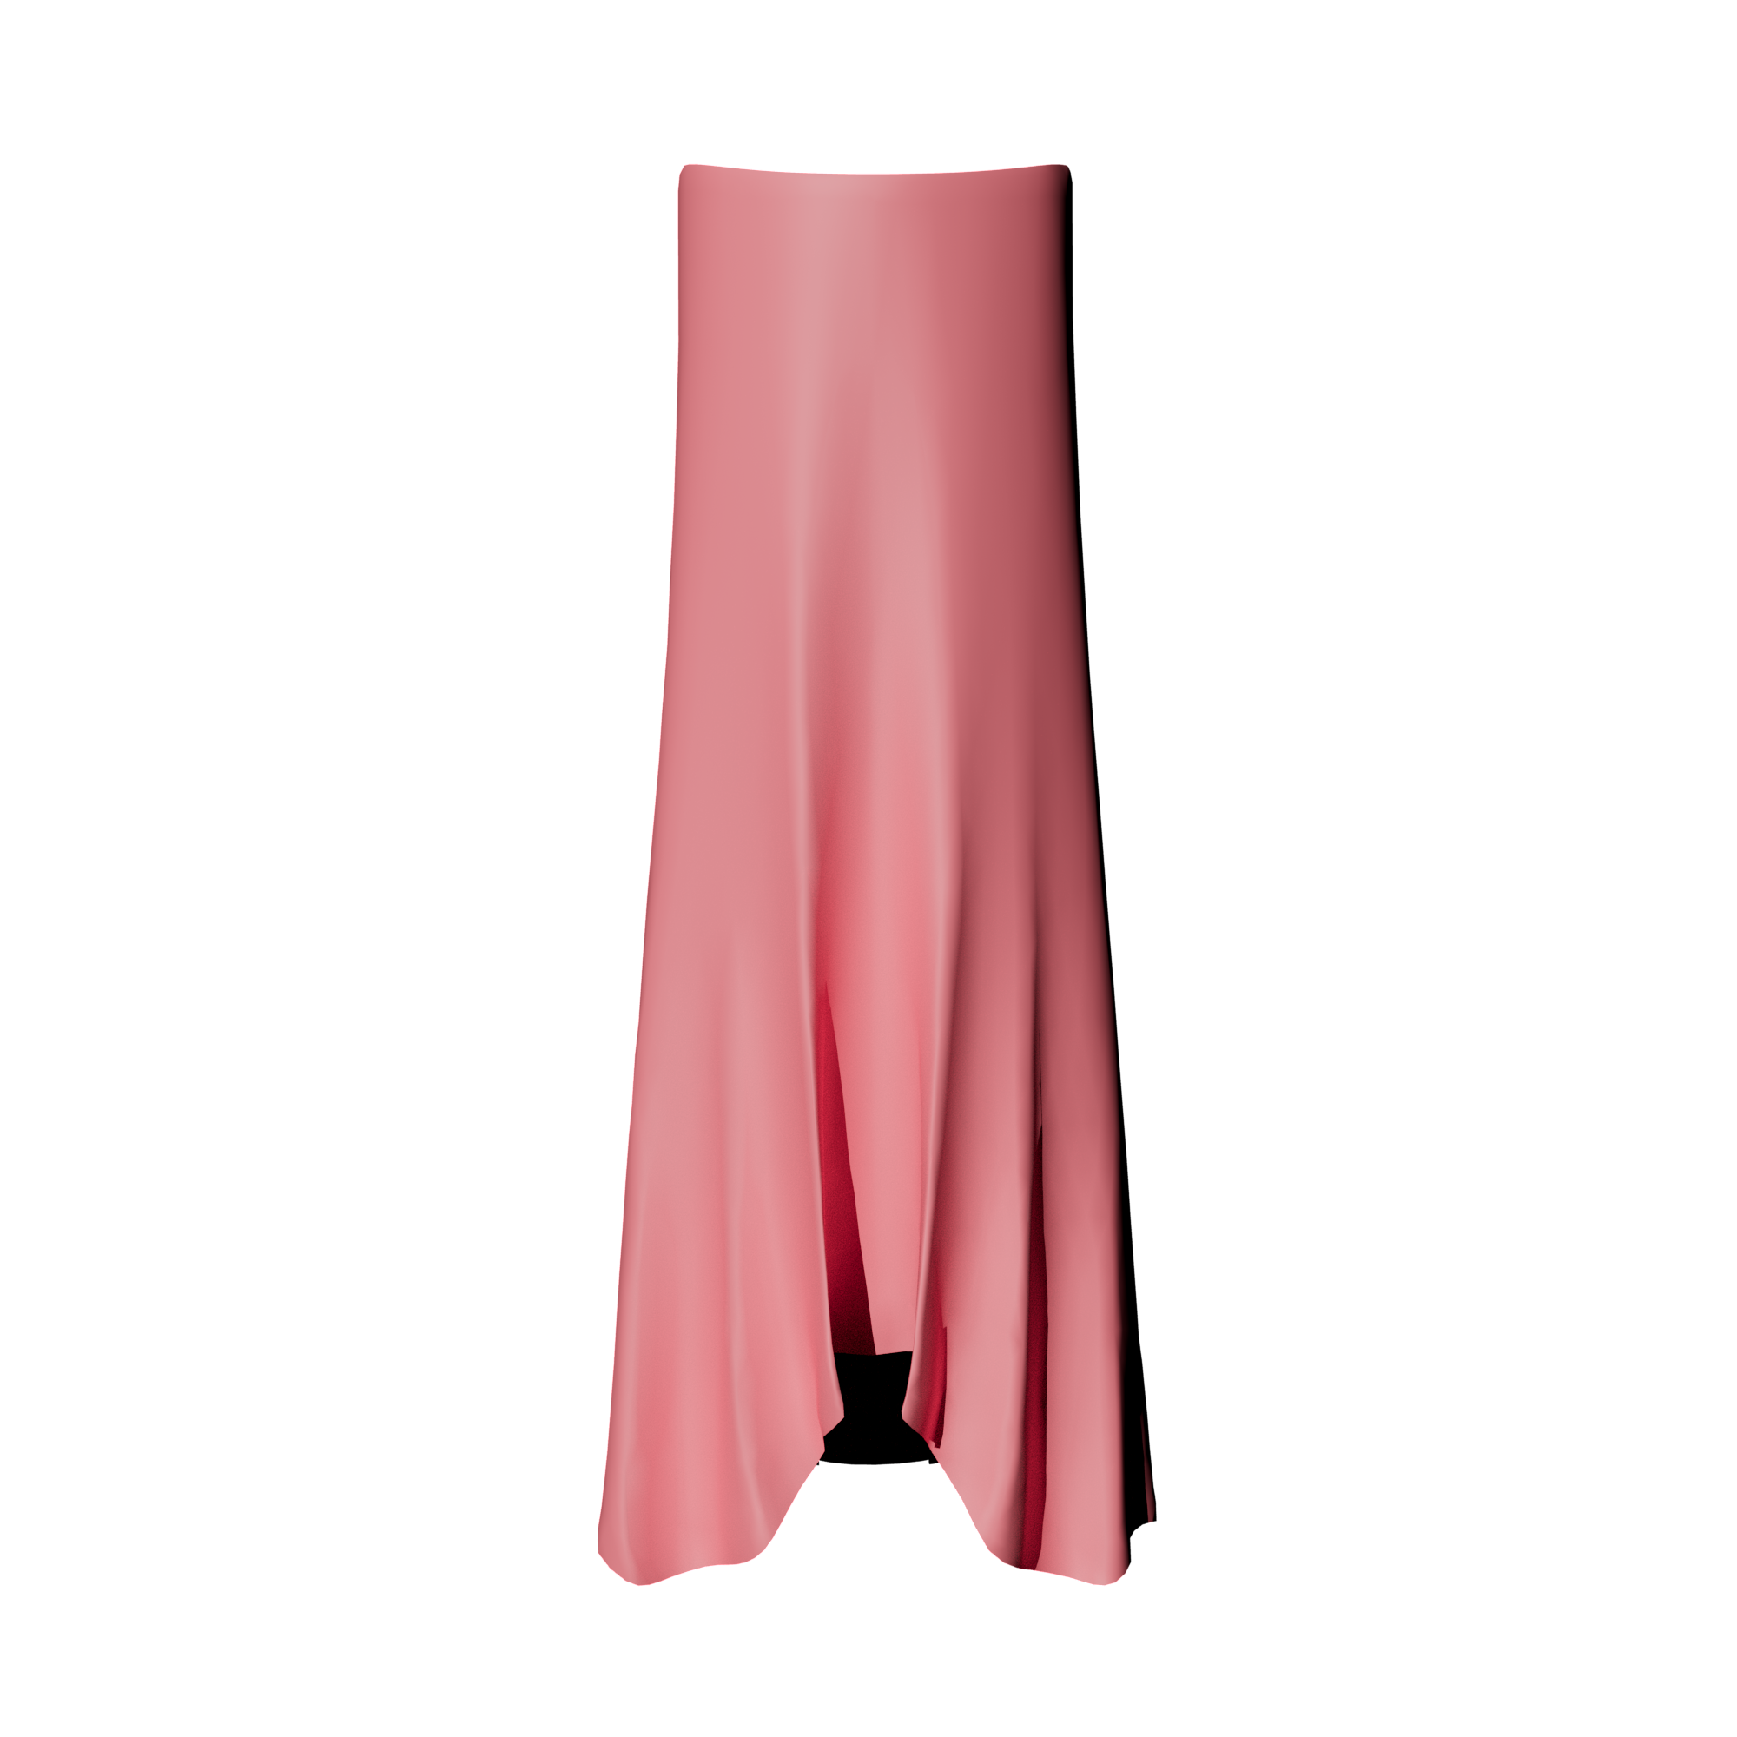
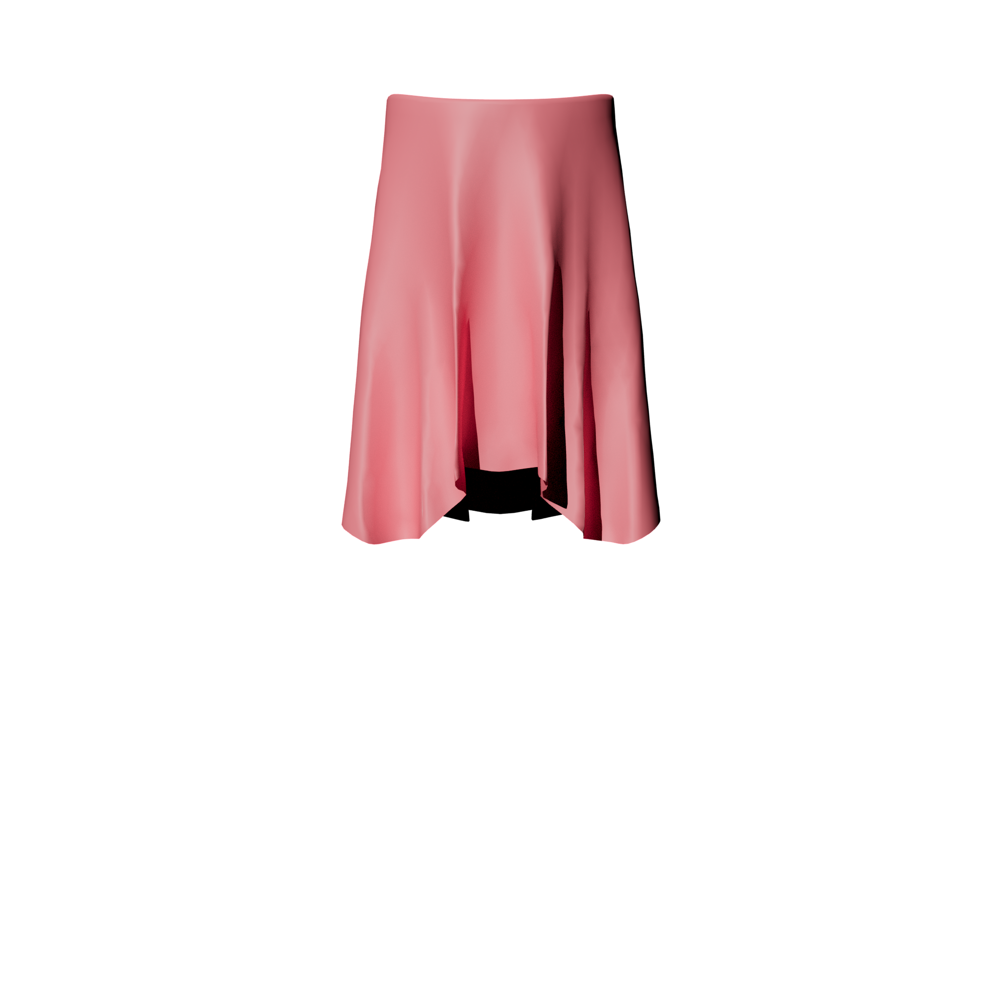
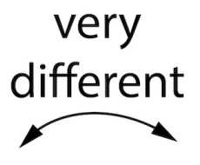
Suspension under different gravity and nonlinearity $p$
Low$p$
High $p$
$1×$ gravity
Neutral shape
$10×$ gravity
$p$ controls nonlinearity!

Slide 27
Material Design
Low nonlinearity
High nonlinearity

Slide 28
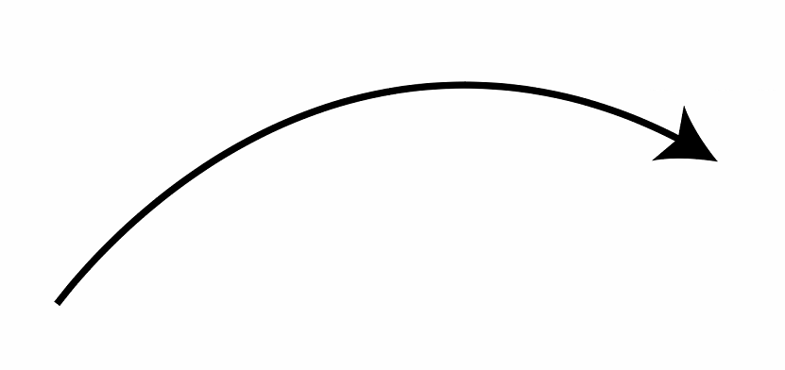
Discretization
$$r_{ijk}: 𝒯→ℝ^{3}, r_{ijk}\left(u,v\right)=x_{i}+u\left(x_{j}−x_{i}\right)+v(x_{k}−x_{i})$$
Discrete Fundamental Forms [Weischedel 2012]
$$a=\left[\begin{matrix}{(x_{j}−x_{i})}^{2} & (x_{j}−x_{i})(x_{k}−x_{i}) \\ (x_{j}−x_{i})(x_{k}−x_{i}) & {(x_{k}−x_{i})}^{2}\end{matrix}\right]$$
$$v$$
$$n_{j}$$
$$n_{k}$$
$$x_{k}$$
$$(0,1)$$
$$x_{i}$$
$$n_{i}$$
$$x_{j}$$
$$b=2\left[\begin{matrix}(n_{i}−n_{j})(x_{i}−x_{j}) & (n_{i}−n_{j})(x_{i}−x_{k}) \\ (n_{i}−n_{k})(x_{i}−x_{i}) & (n_{i}−n_{k})(x_{i}−x_{k})\end{matrix}\right]$$
$$u$$
$$(0,0)$$
$$(1,0)$$
Canonical triangle
Deformed triangle
Mean curvature: $H=tr(a^{−1}b)/2$
Gauss curvature: $K=det(a^{−1}b)$
See implementation details in our paper.

Slide 29
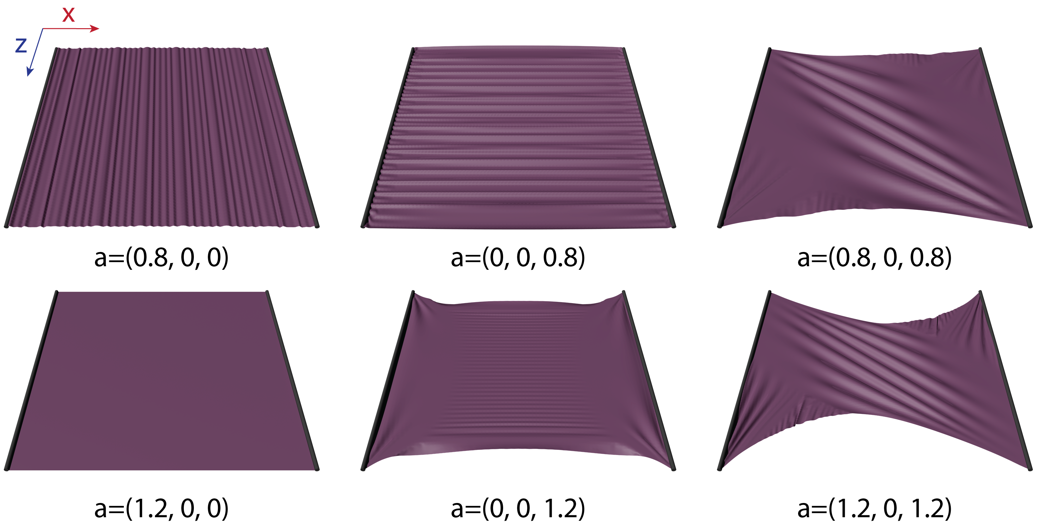
Anisotropic materials
Anisotropic ARAP; a is the anisotropic direction

Slide 30
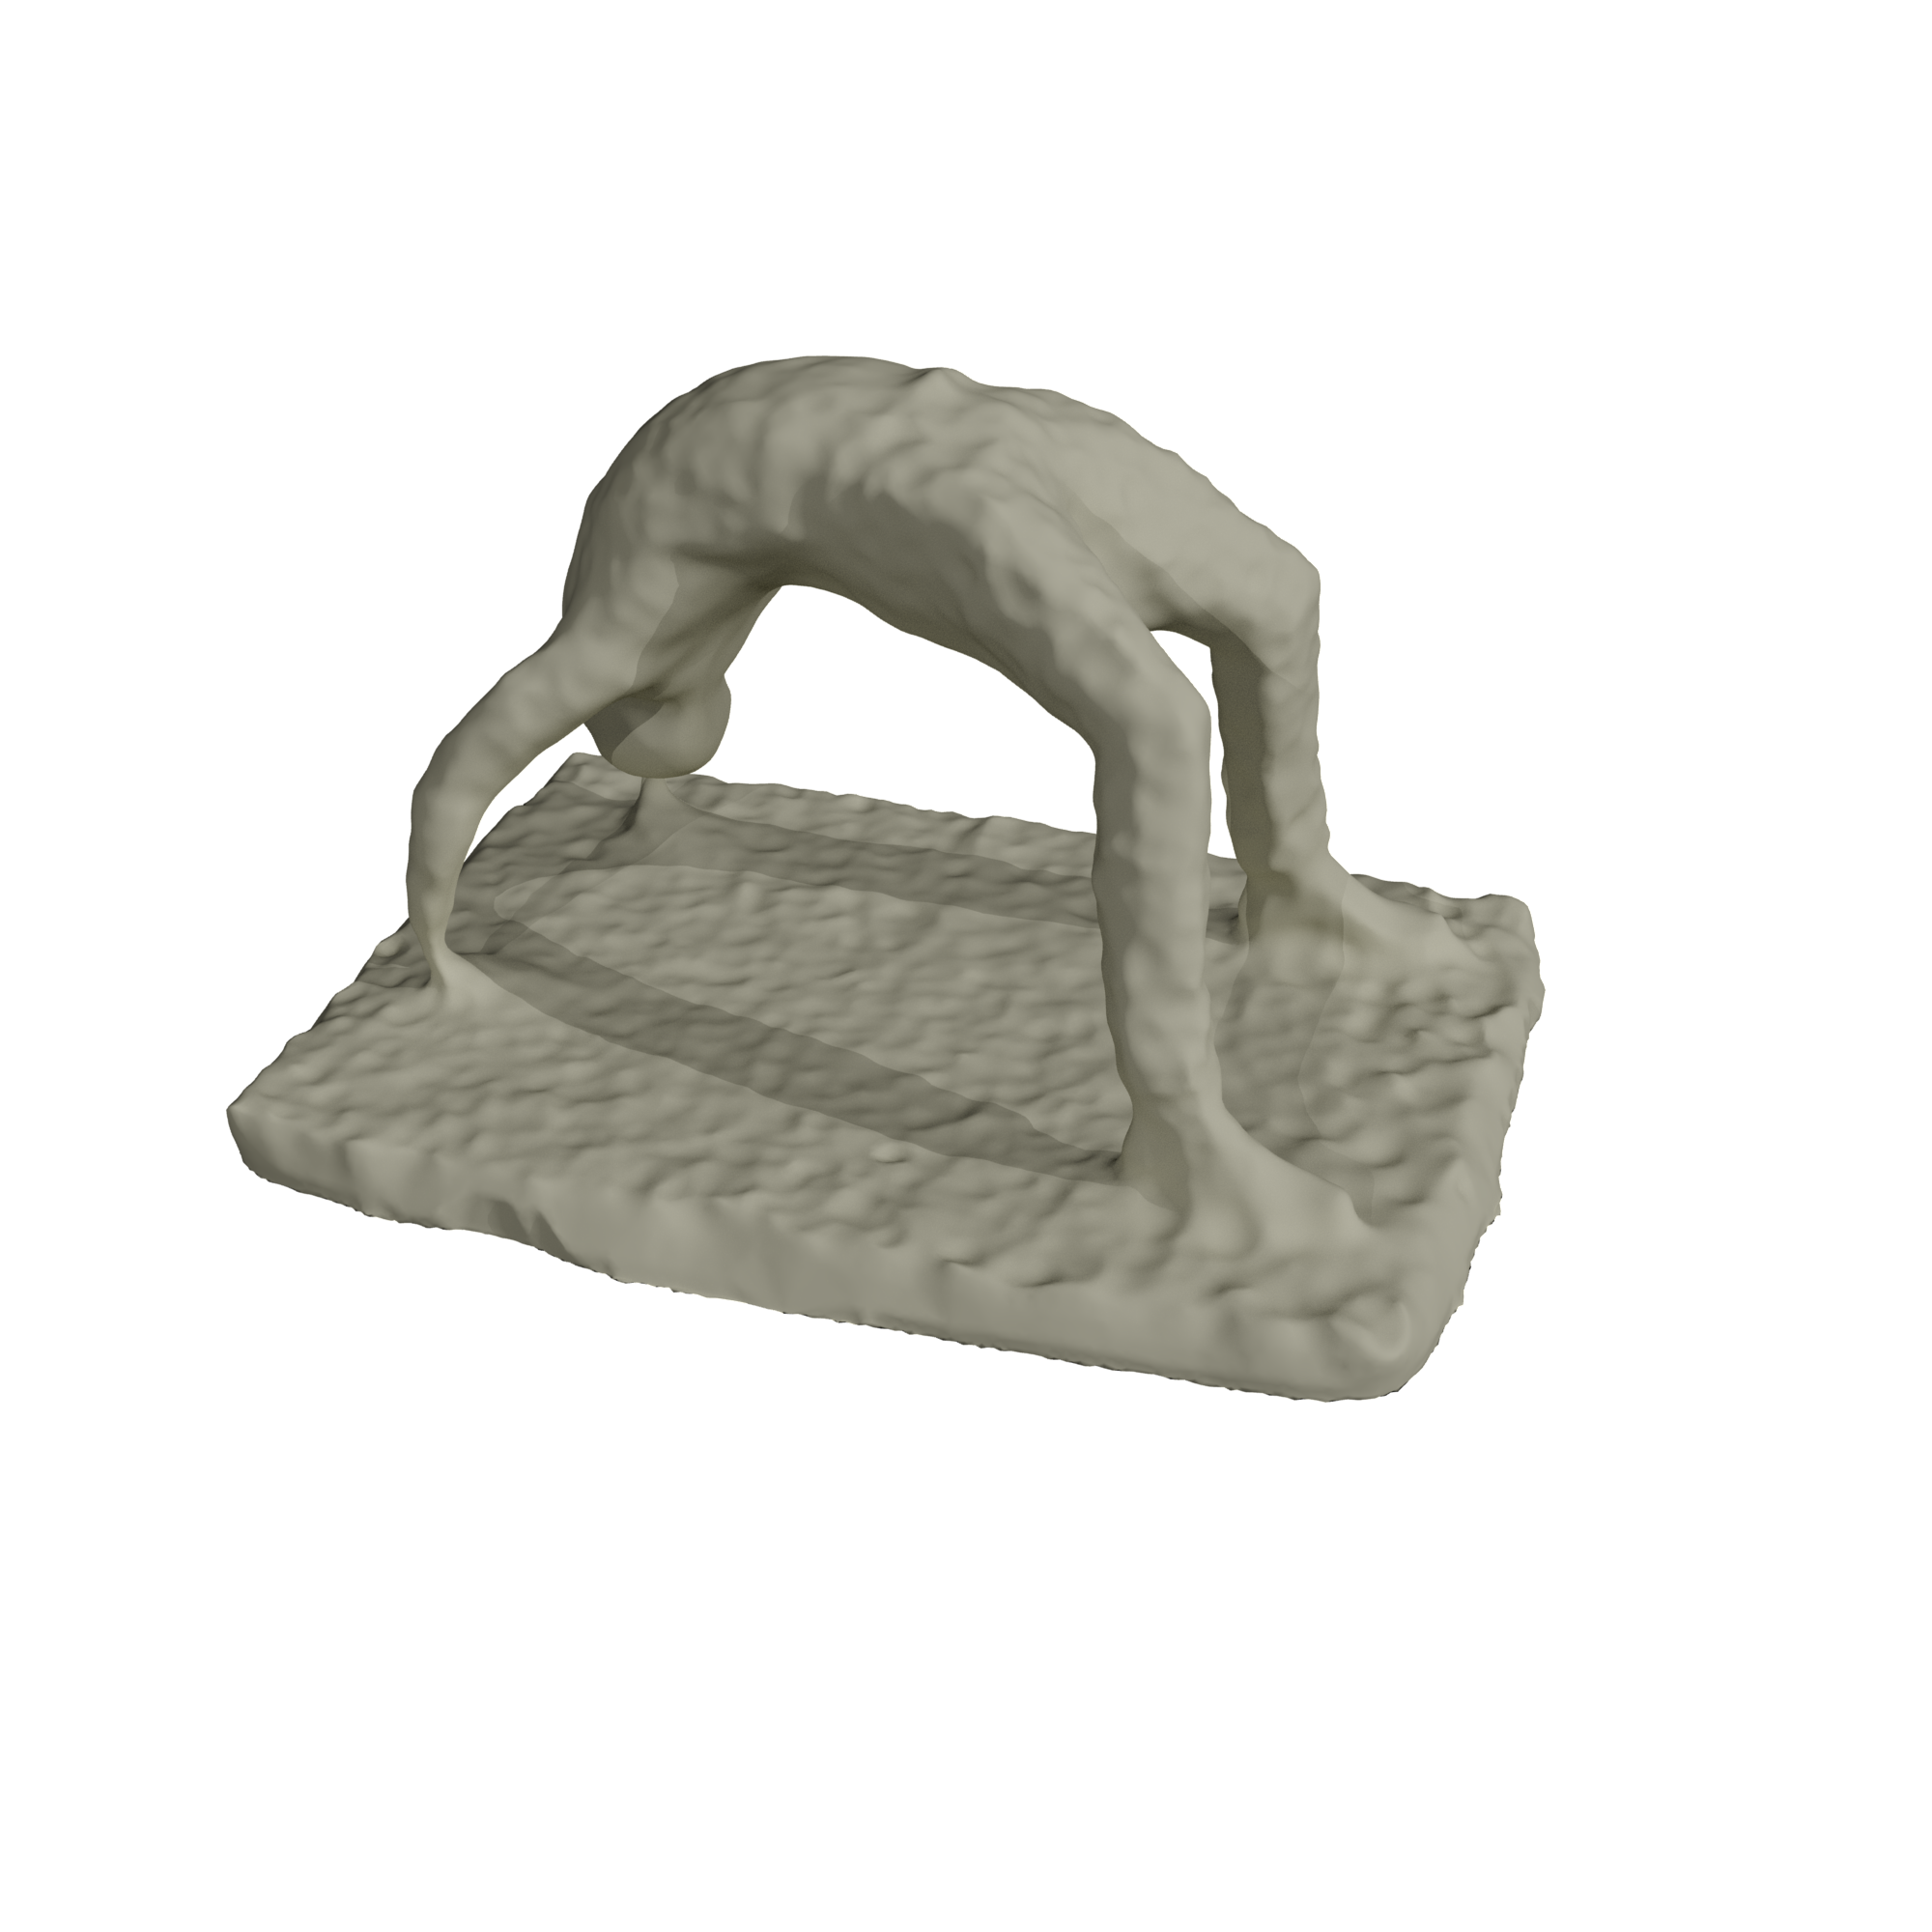
Different materials

Slide 31
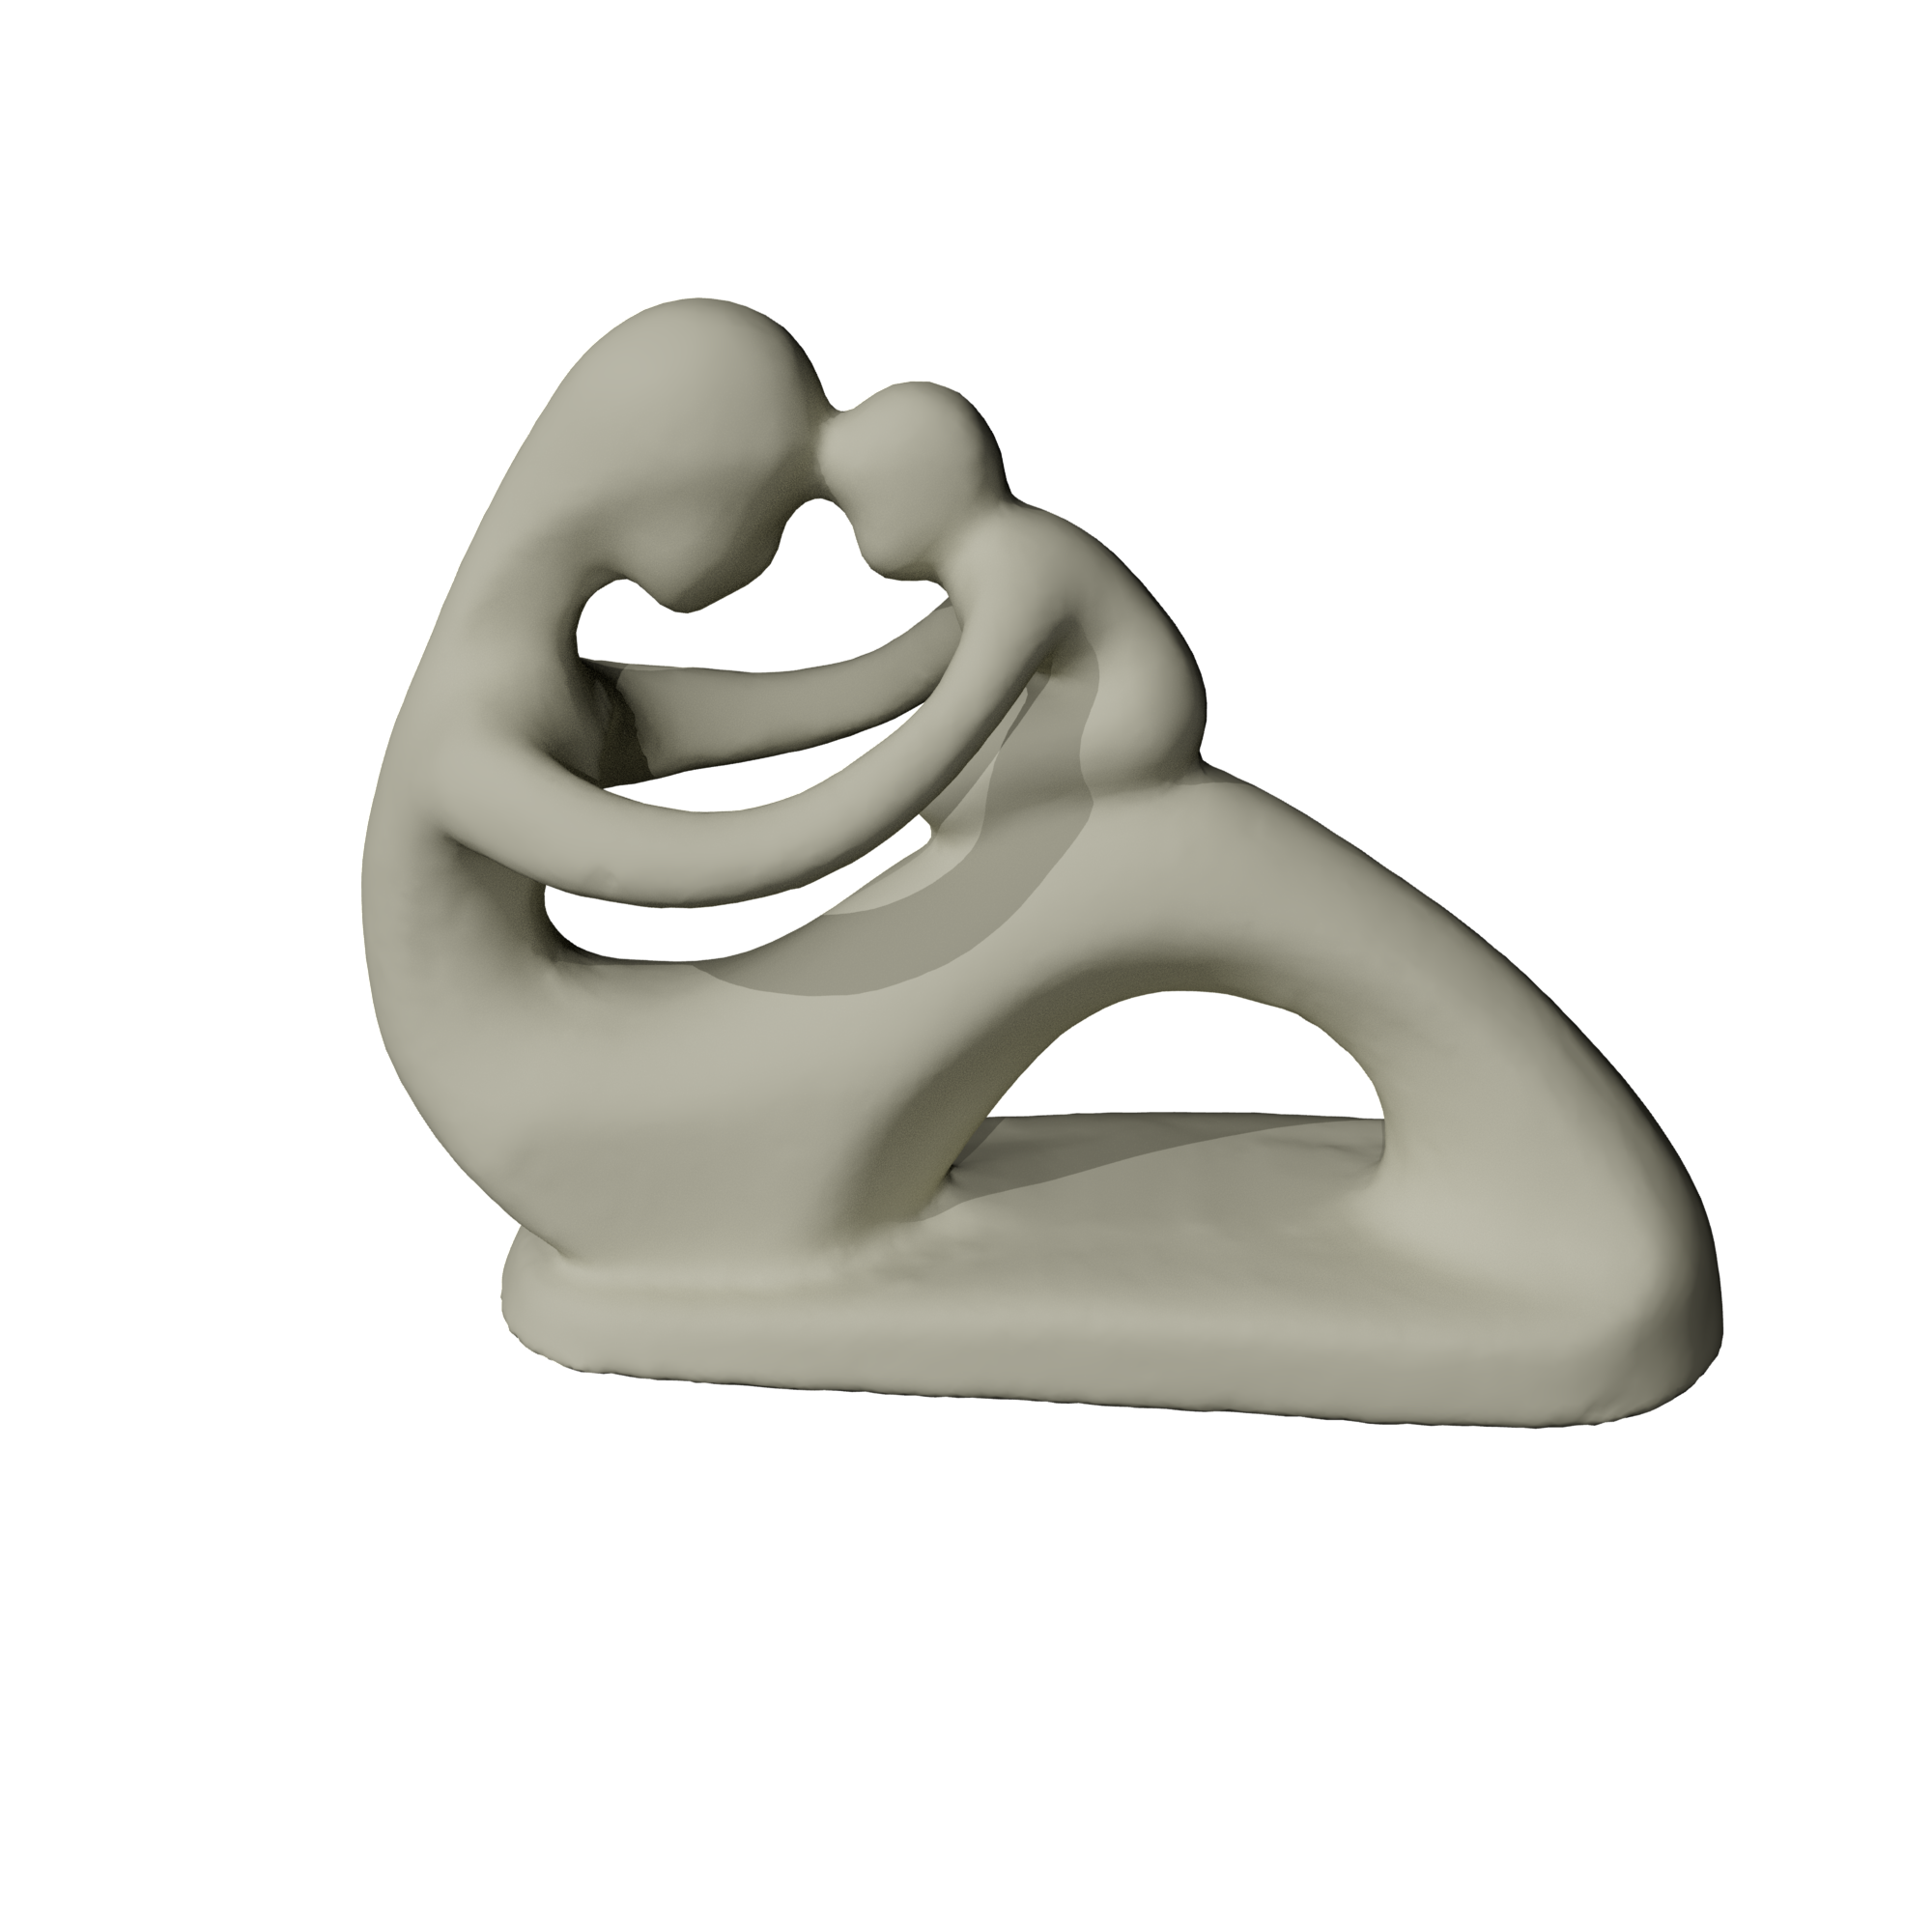
Different materials

Slide 32
Control bendability by changing thickness
Large thickness
Small thickness

Slide 33
Control bendability by changing thickness
Large thickness
Small thickness

Slide 34
Thanks!
No animals were harmed during the simulation ☺

